Slide 1



Getting Started with OpenShift for Developers
Today’s slides are here: dn.dev/openshift-workshop
‹#›

Slide 2


Dad, Dad, someone in a Red Hat has just given me a Kubernetes cluster to play with
- for a week!
Notes:
https://kubernetes.io/docs/tasks/administer-cluster/configure-upgrade-etcd/

Slide 3
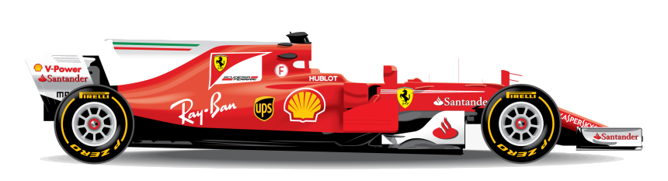


Warming up
Chat with us on Slack! #devnation-lab
Get live help from instructors, download Slack or create an account at slack.com
Ensure you have an account on GitHub or create a new one at github.com/join

Slide 4
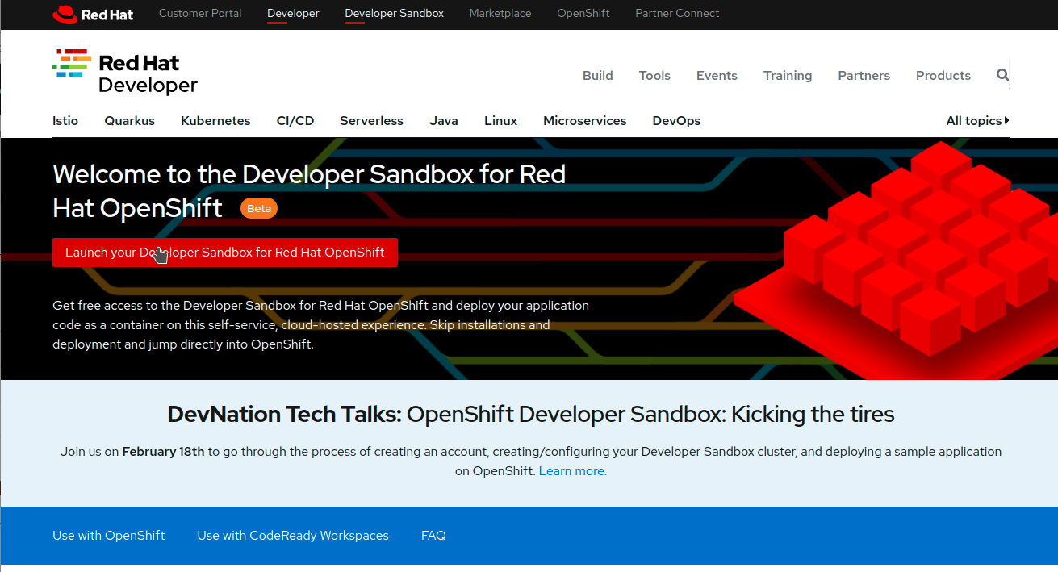
Want More - Developer Sandbox!
Get free access for 30 days to a self-service, cloud-hosted experience with Developer Sandbox for Red Hat OpenShift.
https://developers.redhat.com/developer-sandbox

Slide 5

Agenda - OpenShift Hands-on Workshop
First Part (1 hour)
Hybrid Cloud Demo
Why Kubernetes?
Explore Lab Modules
Walkthrough in Lab
Break/Work on Lab (30 min)
Second Part
Service Mesh Demo
Walkthrough in Lab
Break/Work on Lab (30 min)
Serverless Demo
Kafka with Pacman
Closing

Slide 6
Agenda - OpenShift Hands-on Workshop
First Part (1 hour)
Hybrid Cloud Demo
Why Kubernetes?
Explore Lab Modules
Break/Work on Lab (30 min)
Second Part
Service Mesh Demo
Break/Work on Lab (30 min)
Serverless Demo
Microservices Demo
Closing

Slide 7
Agenda - OpenShift Hands-on Workshop
Workshop (1 hour)
Why Kubernetes?
Explore Lab Modules
Work on Lab

Slide 8

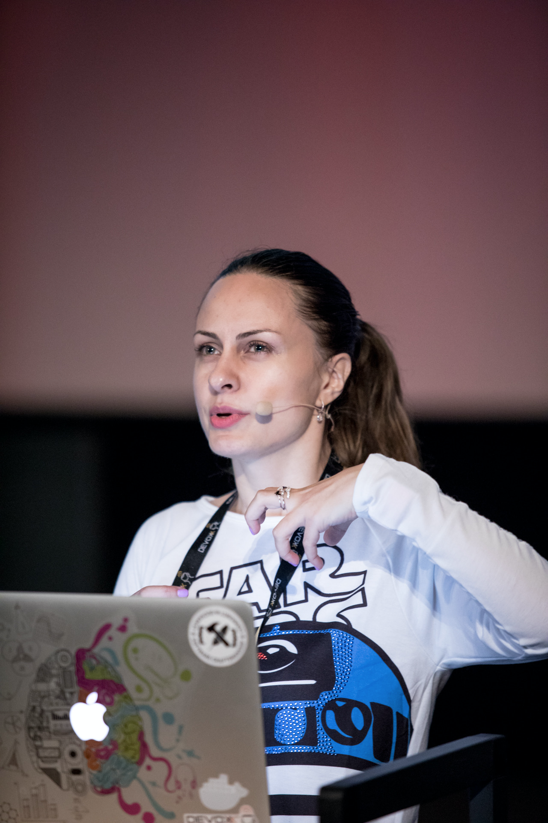

Ana Mihalceanu
@ammbra1508
amihalce@redhat.com
Currently Developer Advocate at RedHat
Java Champion and Certified Architect
Co-founder of Bucharest Software Craftmanship Community
Featured speaker at technology events around the globe
Loving to solve challenging technical scenarios that involve Java-based frameworks and multiple cloud providers
Notes:
Hello!!! I am Ana and I am excited to meet you all today. I currently work as Developer Advocate for RedHat and in the beginning of this of year I became a Java Champion. I have started and still am Java at core, but I like to untangle the complexity of scenarios that also involve Kubernetes and other technologies. I love to share my experiences and experiments within my own community and at various international events.

Slide 9



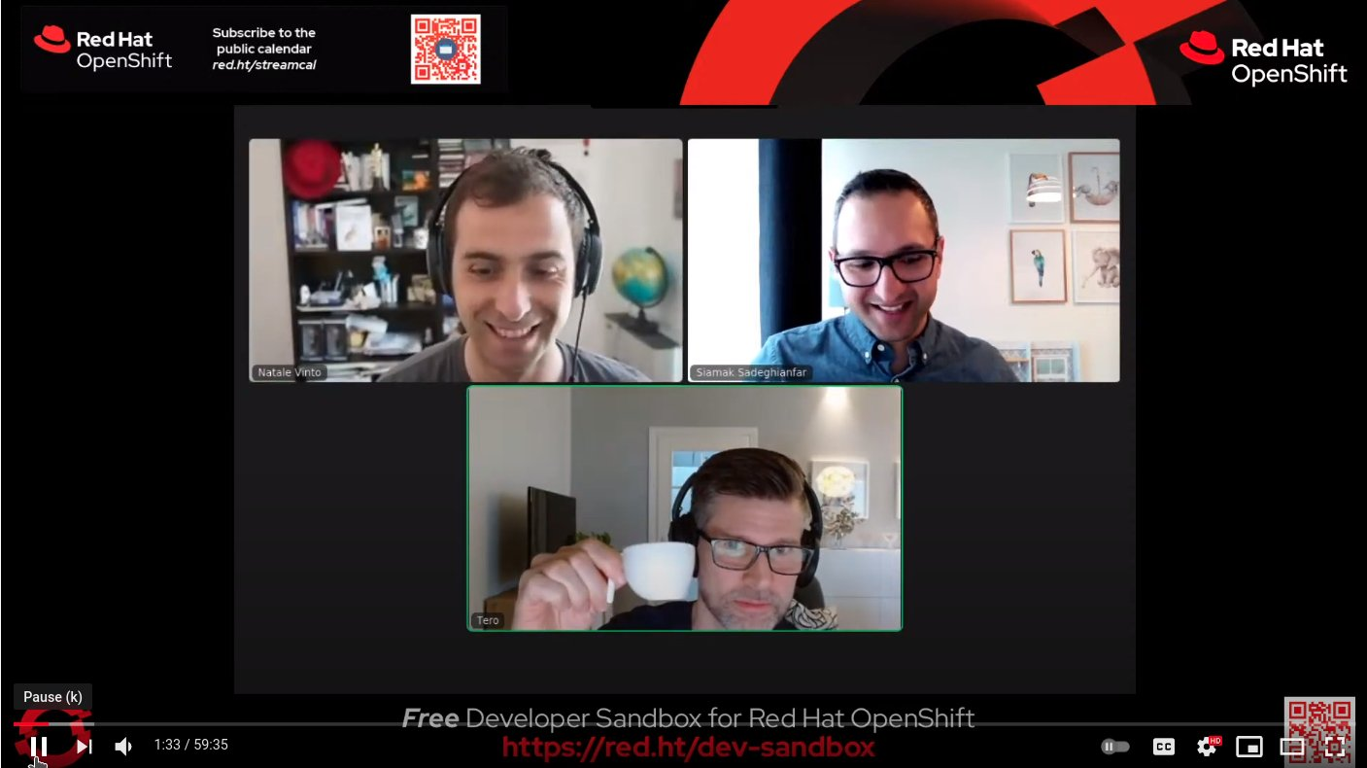
Natale Vinto
$ oc whoami
Developer Advocate for OpenShift, helping people within communities and customers having success with their Kubernetes and Cloud Native strategy.
Love Free and Open Source software, Blues 🎸 and coffee ☕
@natalevinto
OpenShift.TV Coffee Break Bi-Weekly on Wed 10 AM CEST

Slide 10

Fabio Di Vita
$ oc whoami
Solution Architect working with Global System Integrator across EMEA. Developer Background
Preferred Quote
Sometimes you eat the bar, sometimes the bar eats you
OpenShift.TV Coffee Break Bi-Weekly on Wed 10 AM CEST

Slide 11

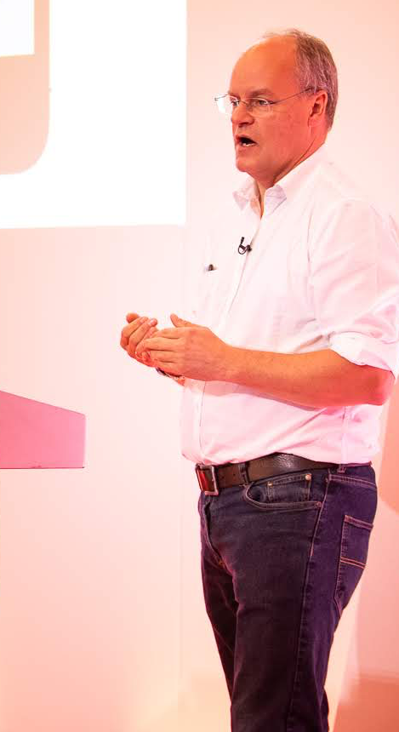

Alex Groom
Based in UK
Specialist Solution Architect, EMEA
Focus on OpenShift Developer Adoption
+25 years in Software Development
First UNIX experience 1984
First Java experience with V1.1 in 1997
First C# experience VS .NET 2002
agroom@redhat.com
Notes:
Suggest each introduce ourselves in a couple of sentences

Slide 12
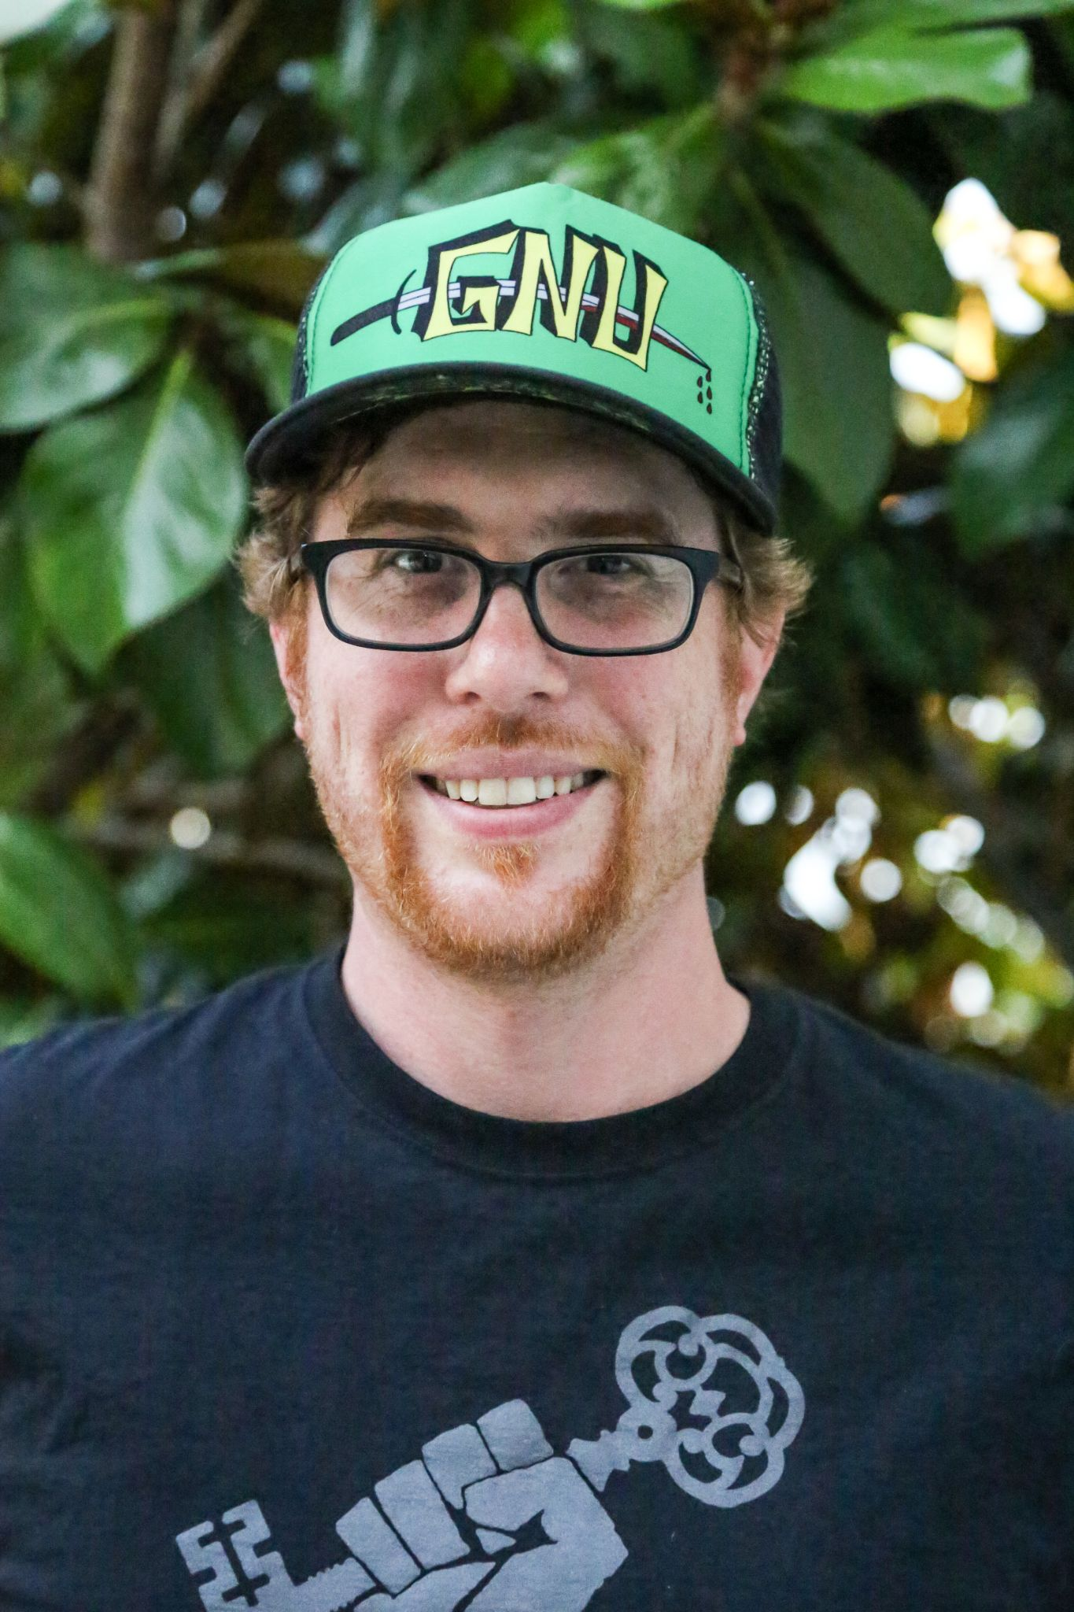


Ryan Jarvinen
$ oc whoami
Developer Advocate for OpenShift
CoreOS, Kubernetes
JavaScript, Python, Ruby, PHP
learn.openshift.com
DevExp OfficeHours,
Tuesdays on openshift.tv
@RyanJ

Slide 13



Sébastien Blanc
@sebi2706
sblanc@redhat.com
Currently Red Hat’s Director of Developer Experience
Featured speaker at technology events around the globe
Java Champion
Co-organizer of Riviera DEV
Passion-Driven-Developer with one goal : share his passion by giving talks that are pragmatic, fun and focused on live coding

Slide 14
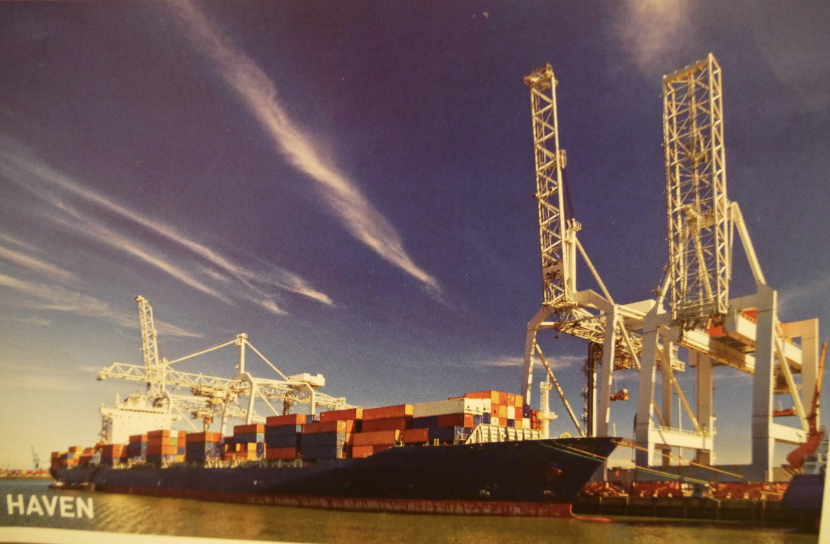
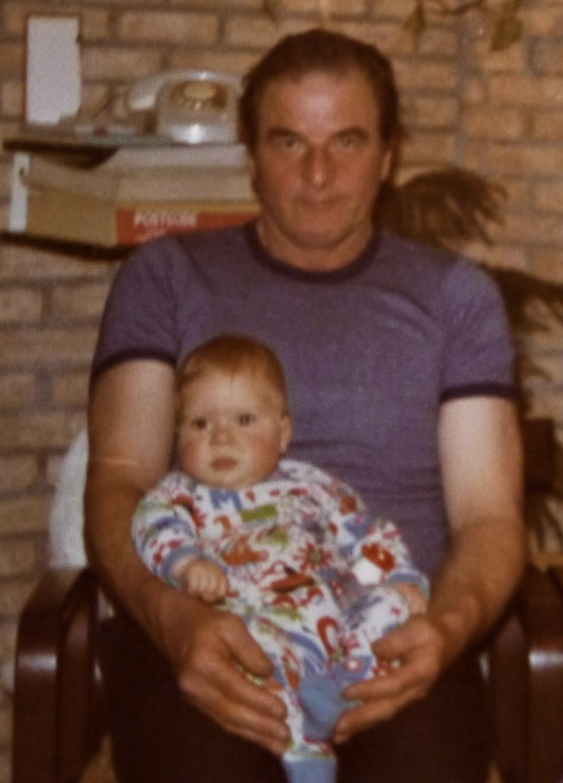

Slide 15
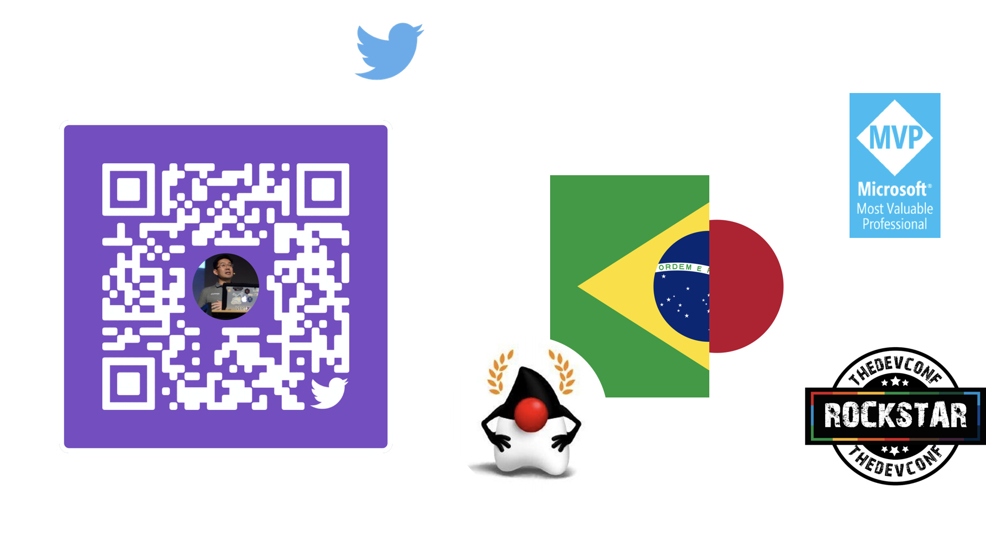
@yanaga

Slide 16
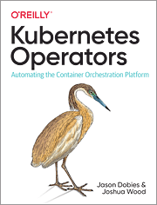

Jason Dobies
+------------------------------+
| /\ |
| || {} |
| || .--. |
| || /.--.\ |
| || |====| |
| || |`::`| |
| _||_ .-;`\..../`;_.-^-._ |
| /\\ / |...::..|` : `| |
| |:'\ | /'''::''| .:. | |
| \ /\;-,/\ :: |..:::::..| |
| \ <` > >._::_.| ':::::' | |
| `""` / ^^ | ':' | |
| | \ : / |
| | \ : / |
| |___/\___|`-.:.-` |
| \_ || _/ ` |
| <_ >< _> |
| | || | |
| | || | |
| _\.:||:./_ |
| /____/\____\ |
+------------------------------+
+-----------------------------------------------+
| Name: Jason the All Knowing |
| Race: Human Strengths: |
| Alignment: Chaotic Good - Python |
| Stats: - OpenShift |
| - Intelligence: 20 - Kubernetes |
| - Strength: 17 - Being Awesome |
| - Charisma: 3 Weaknesses: |
| - Dexterity: 1 - Semicolons |
| - Exiting Vi |
| - Actual Pythons |
+-----------------------------------------------+

Slide 17


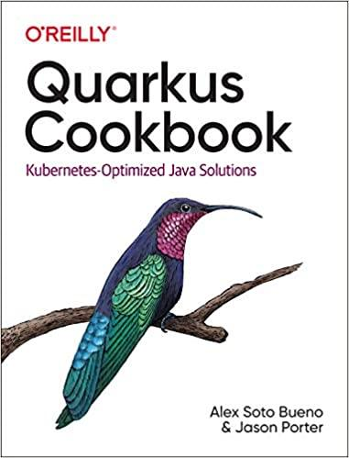
Alex Soto (lordofthejars.com)
@alexsotob
asotobue@redhat.com
Currently Red Hat’s Director of Developer Experience
Featured speaker at technology events around the globe
A Java Champion since 2017
Writer, University Professor, Radio collaborator
A big fan of testing and continuous delivery in 21st century

Slide 18





@madou_coulibaly
Specialist Solution Architect, EMEA
Focus on OpenShift Developer Adoption
+13 years in Software Development
+6 years in Business Intelligence

Slide 19


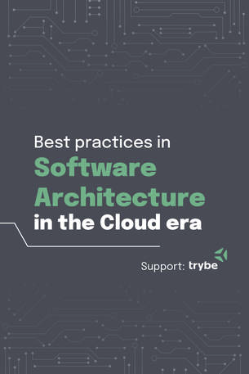

@elderjava
eldermoraes.com/join
Developer Advocate at Red Hat
Java Champion
Board Member at SouJava
Featured speaker at developers conferences around the world
Helps Java developers to build and deliver awesome applications

Slide 20


@elderjava
youtube.eldermoraes.com
Developer Advocate at Red Hat
Java Champion
Board Member at SouJava
Featured speaker at developers conferences around the world
Helps Java developers to build and deliver awesome applications

Slide 21
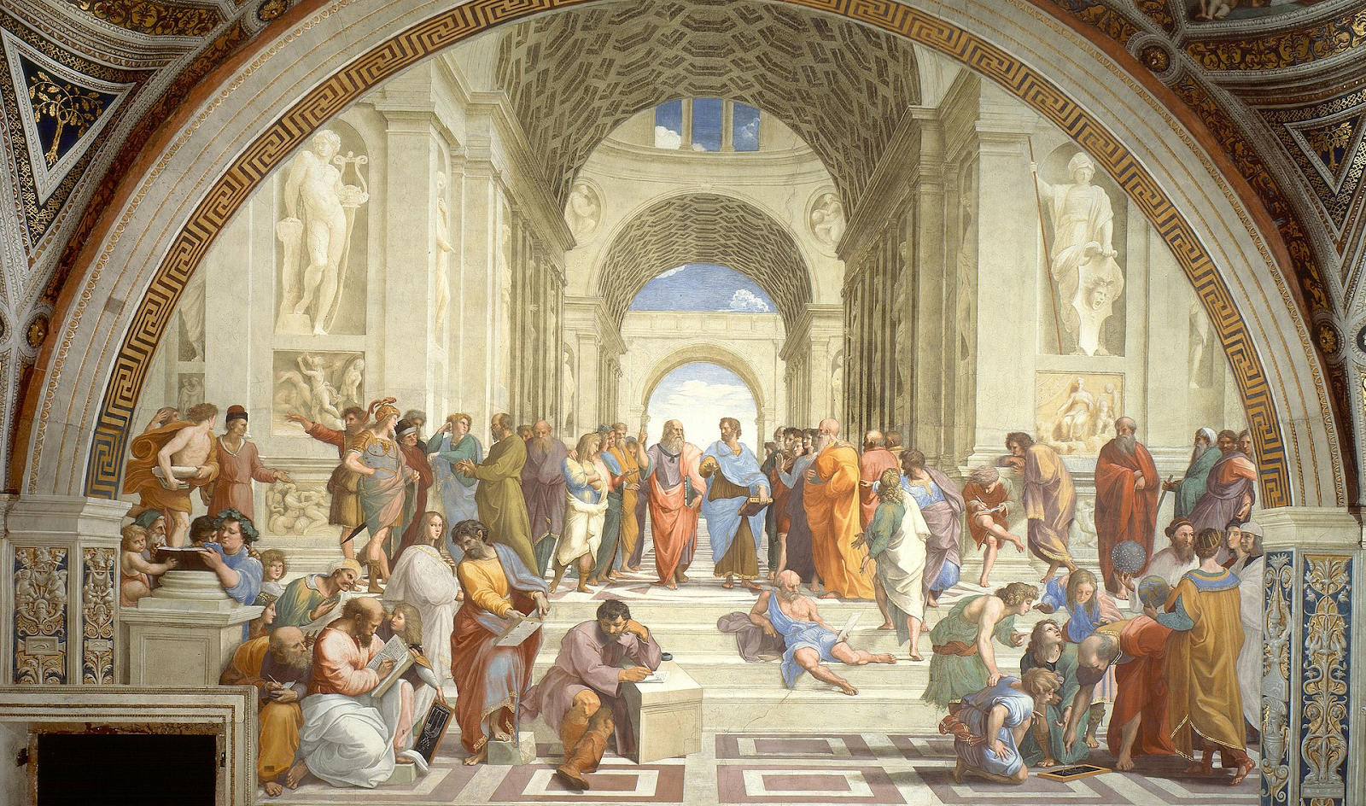

Who are you?
Code
Management
Infrastructure
https://www.menti.com/q5a9g5vqnm
The School of Athens - Raphael

Slide 22


Hybrid Cloud

Slide 23
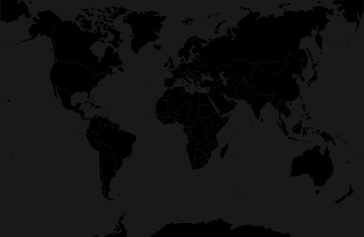







Why developers care about Hybrid Cloud?
Applications can easily be made highly scalable and available
Platform looks the same wherever it runs - same APIs and rich UI
Applications can be developed and deployed in the same way
Clusters typically stretch across cloud AZ for data center resilience
But what about load balancing and HA across clusters running in different cloud providers?
It would need multiple data centers to fail to halt your application!
X
X

Slide 24

IBM Cloud
GCP
AWS
Live Demo
https://github.com/redhat-developer-demos/hybrid-cloud/

Slide 25


Slide 26
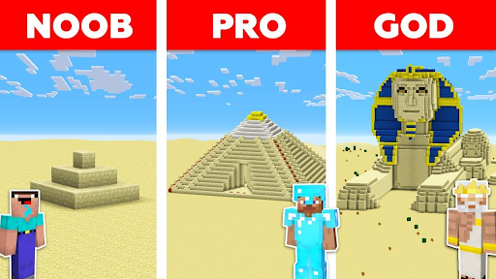

What’s your experience level?
https://www.menti.com/ne87oijii3

Slide 27
Why Kubernetes?

Slide 28
The Application

Slide 29
Modules

Slide 30
Microservices

Slide 31
Microservices

Slide 32
Microservices

Slide 33
Network of Services

Slide 34
Microservices own their Data

Slide 35


Old School New School
Love Thy Mono

Slide 36

Container Technology
Supporting Modern Apps workloads
Cloud Native
Portable and interoperable
Mature technology

Slide 37



DEVELOPERS
Cloud-native apps
Simplified packaging
Simplified testing
CONTAINERS
Container
Container
Container
Container
IT OPERATIONS
Consistent app deploys
Automated app deploys
Improved app performance
Multi-cloud consistency
App
App
App
App
LINUX HOST (KERNEL)
BUSINESS LEADER
CLOUD INFRASTRUCTURE
Enable devops culture
Enable hybrid cloud
Reduce vm licensing costs
Accelerate app-dev cycles

Slide 38
Container Image Layers
Image Layer 3
Application Layer
Image Layer 2
Java Runtime Layer
Image Layer 1
OS Update Layer
Base Image
Base RHEL
Container Image Layers
Example Container Image

Slide 39
Dockerfile: create your Container
1
Inherit from a base image
FROM registry.access.redhat.com/ubi8/ubi
2
Parameters as environment variables
ENV foo=text
3
Install dependencies (tooling from base image)
RUN dnf install -y java-11-openjdk
4
Add your app as a new Layer
ADD my-app.jar /home/my-app.jar
5
Expose the port your app will use
EXPOSE 8080
6
Run the app
CMD java -jar /home/my-app.jar

Slide 40
DevOps Challenges - Multiple Containers
How to scale?
How to avoid port conflicts?
How to manage them on multiple hosts?
What happens if a host fails?
How to keep them running continuously?
How to update them?
Rebuild Container Images?

Slide 41
Meet Kubernetes
Greek for “Helmsman”
Container orchestrator
Supports multiple cloud and bare-metal environments
Inspired by Google’s experience with containers
Open source, written in Go
Manage applications, not machines

Slide 42
What is Kubernetes?

Slide 43


Kubernetes Terms - Pod
1+ containers
Single IP address
Shared storage (ephemeral)
Shared resources
Shared lifecycle
Notes:
A group of whales is commonly referred to as a pod and a pod usually consists a group of whales that have bonded together either because of biological reasons or through friendships developed between two or more whales.
In many cases a typical whale pod consists of anywhere from 2 to 30 whales or more.

Slide 44
Kubernetes Terms - Deployment/ReplicaSet
The Desired State - replicas, pod template: health checks, resources, image

Slide 45
Kubernetes Terms - Service
Grouping of pods (acting as one) has stable virtual IP and DNS name

Slide 46
Kubernetes Terms - Persistent Volume
Network available storage
PVs and PVCs

Slide 47
Kubernetes Terms - Labels
Key/Value pairs associated with Kubernetes objects (env=production)

Slide 48








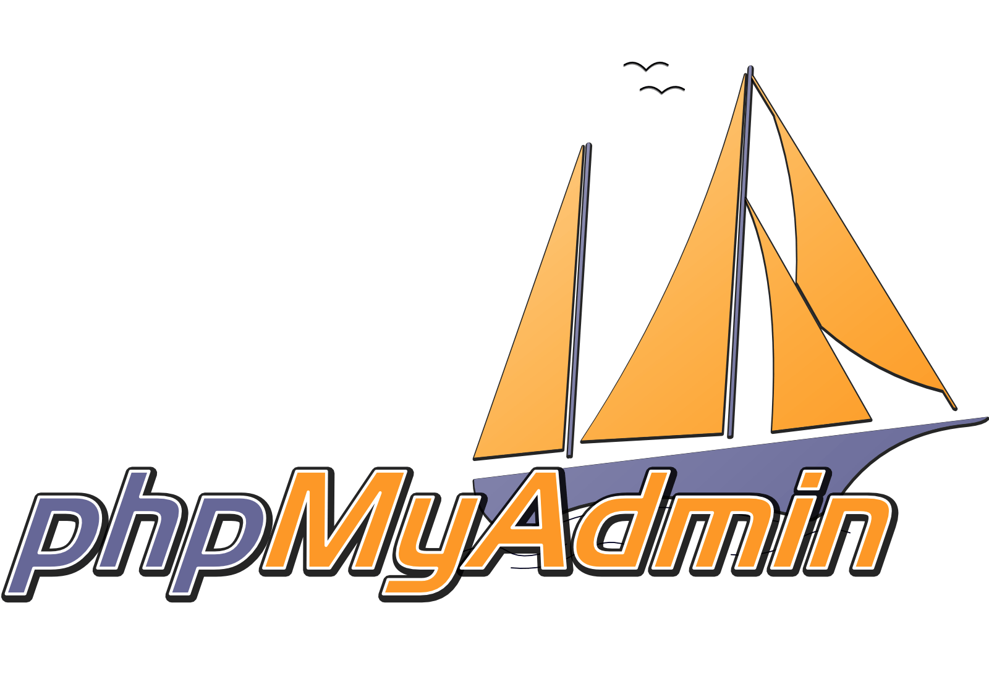
Kubernetes Cluster - Nodes
Node
kubelet
Node
kubelet
Node
kubelet
Primary
Dev
api
etcd
scheduler
Node
kubelet
Node
kubelet
Node
kubelet
controllers
Istio proxy
Ops
Notes:
https://kubernetes.io/docs/tasks/administer-cluster/configure-upgrade-etcd/

Slide 49
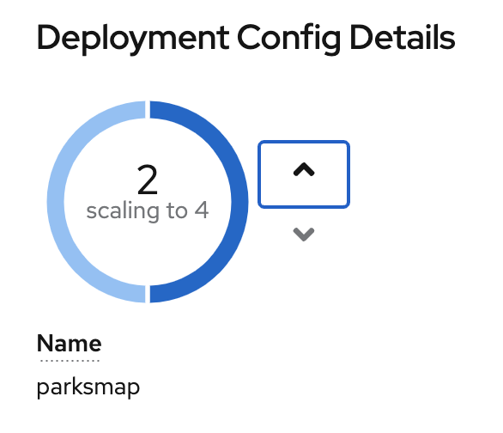
Kubernetes Cluster - Declarative
Dev
Ops
Notes:
https://kubernetes.io/docs/tasks/administer-cluster/configure-upgrade-etcd/

Slide 50

Kubernetes Cluster - 4 Tomcats
Node
kubelet
Node
kubelet
Node
kubelet
Node
kubelet
Node
kubelet
Node
kubelet
Istio proxy
Notes:
https://kubernetes.io/docs/tasks/administer-cluster/configure-upgrade-etcd/

Slide 51
Kubernetes Cluster - Pod Fail
Node
kubelet
Node
kubelet
Node
kubelet
X
Node
kubelet
Node
kubelet
Node
kubelet
Istio proxy
Notes:
https://kubernetes.io/docs/tasks/administer-cluster/configure-upgrade-etcd/

Slide 52
Kubernetes Cluster - Correcting
Node
kubelet
Node
kubelet
Node
kubelet
Node
kubelet
Node
kubelet
Node
kubelet
Istio proxy
Notes:
https://kubernetes.io/docs/tasks/administer-cluster/configure-upgrade-etcd/

Slide 53
Kubernetes Cluster - Node Fail
Node
kubelet
Node
kubelet
Node
kubelet
X
Node
kubelet
Node
kubelet
Node
kubelet
Istio proxy
Notes:
https://kubernetes.io/docs/tasks/administer-cluster/configure-upgrade-etcd/

Slide 54
Kubernetes Cluster - Pods Replaced
Node
kubelet
Node
kubelet
Node
kubelet
Node
kubelet
Node
kubelet
Istio proxy

Slide 55
Lab Modules

Slide 56
Prerequisites
Component | Version
OpenShift Container Platform | 4.6
OpenShift Pipeline | 1.2.3
Slack.com access | #spanish-lab
Install oc CLI tool | 4.6.x
GitHub.com Account
git client | >= 2.0
Java toolchain - JDK | >=11
Maven | >=3.6.3

Slide 57
Prerequisites
Component | Version
OpenShift Container Platform | 4.8
OpenShift Pipeline | 1.5.1
Slack.com access | #devnation-labs
Install oc CLI tool | 4.8.x
GitHub.com Account
git client | >= 2.0
Java toolchain - JDK | >=11
Maven | >=3.6.3

Slide 58
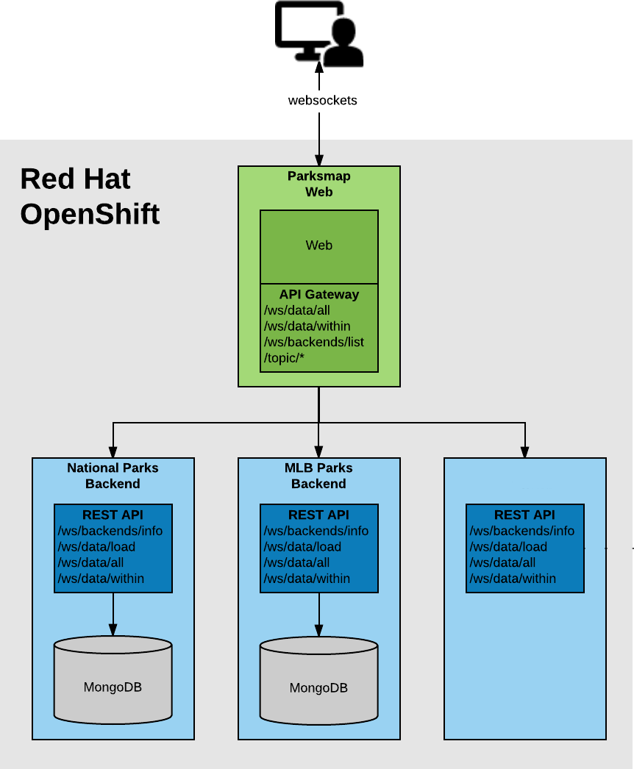
Parksmap Architecture

Slide 59
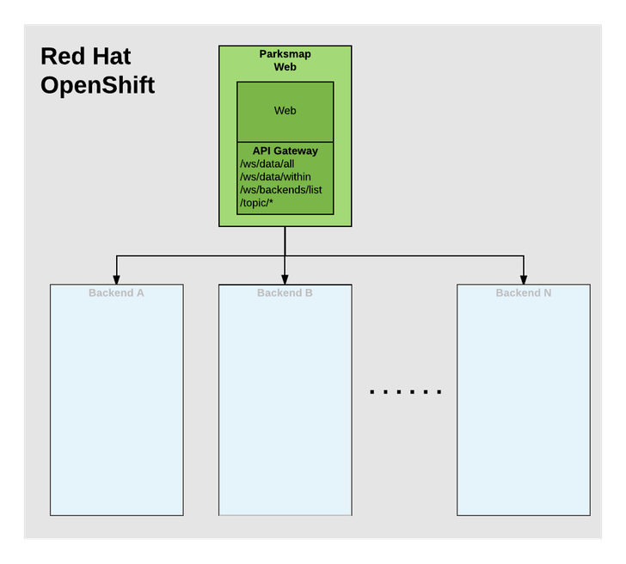



Parksmap Web
Your First App deployment from OpenShift Developer Console
Spring boot frontend to display a World map with data points
Container Image available publicly from Quay.io
Interacts with different backends exposing same REST endpoints
Can integrate an API Gateway

Slide 60
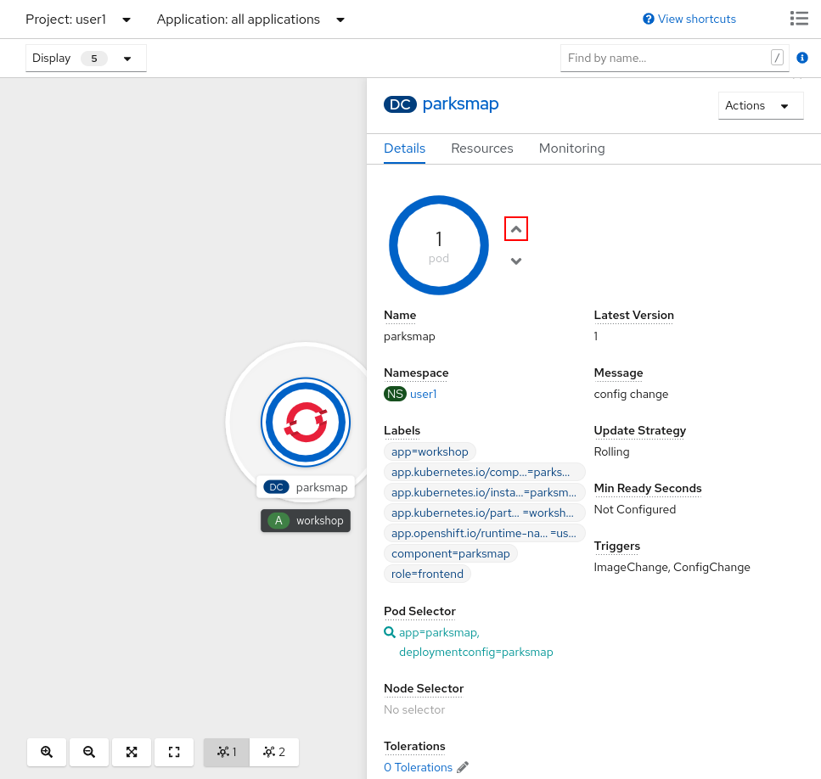
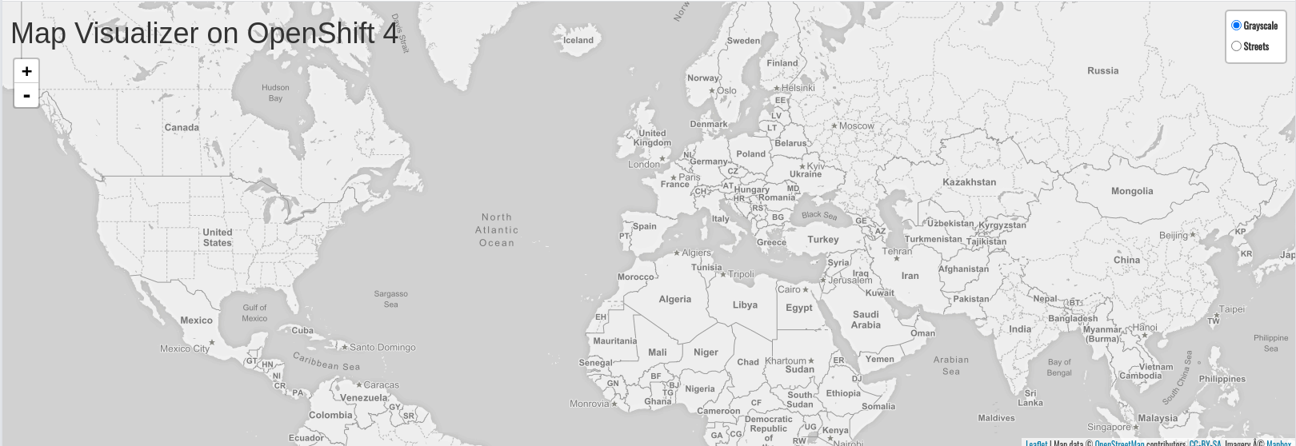
Parksmap App: Exploring OpenShift
Scaling Apps
Logging
Labels
Permissions
Accessing and debugging Containers

Slide 61
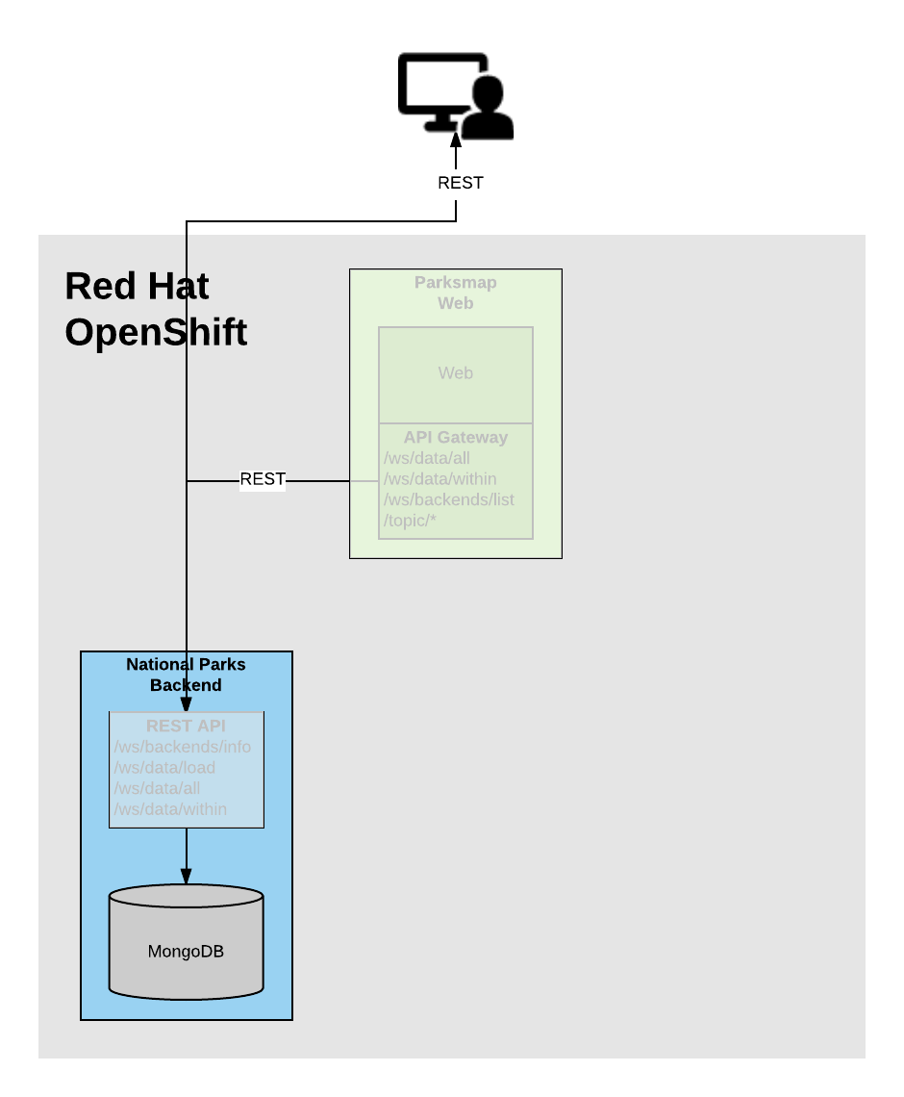
NationalParks: Backend
You create Container Image automatically from source code using S2I
Spring boot backend shows World-wide National Parks
Uses MongoDB Database to save and retrieve data as geo-locations
Exposes REST APIs for Parksmap frontend

Slide 62
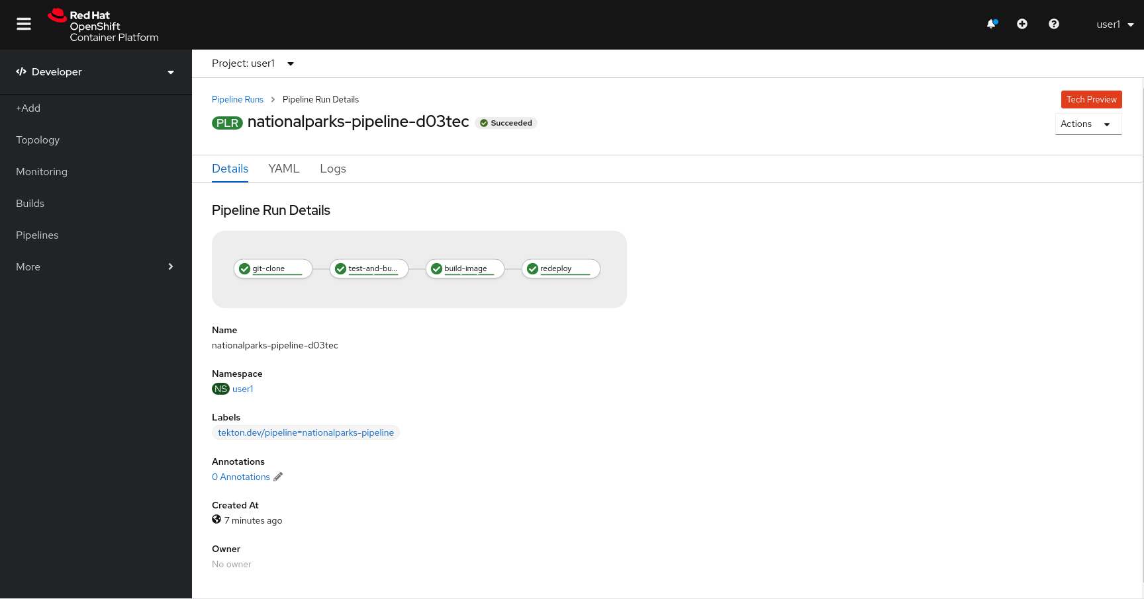
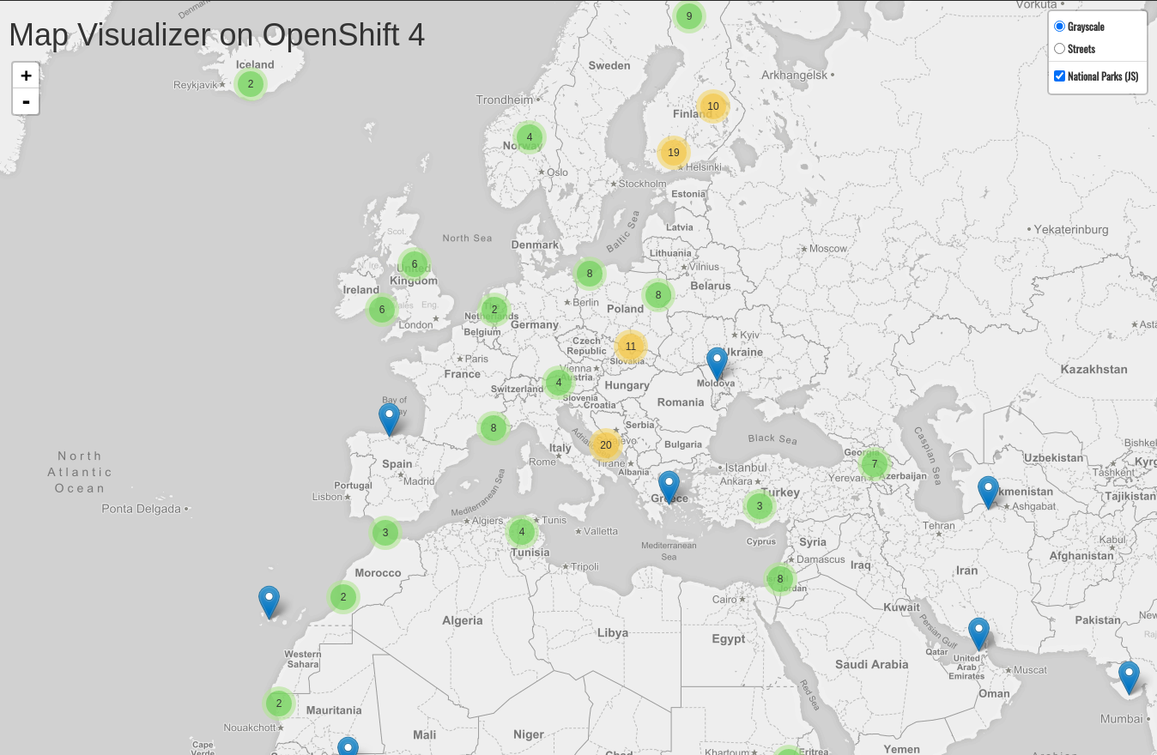

NationalParks: Exploring OpenShift
Health Checks
Automation with Pipelines
Web Hooks to build and deploy automatically from code changes

Slide 63
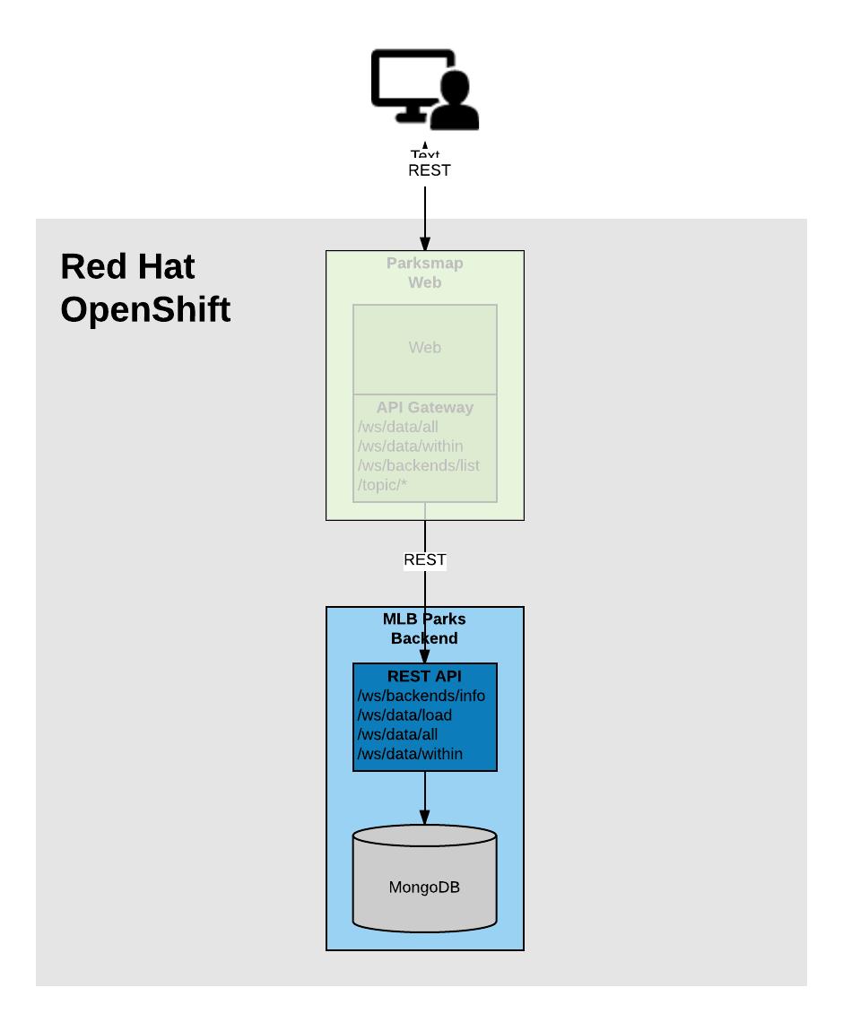

MLB Parks Backend
You create and deploy Container Image to OpenShift with S2I Binary Builds
Java EE backend to show Major League Baseball Stadiums in North America
Build artifacts (.war) locally with your IDE or workstation

Slide 64
Hands On Now!

Slide 65
Get your Lab Guide Link
https://developers.redhat.com/developer-sandbox
https://bit.ly/codemotion-openshift
https://redhat-scholars.github.io/openshift-starter-guides/rhs-openshift-starter-guides/4.8/index.html

Slide 66
https://github.com/redhat-scholars/openshift-starter-guides

Slide 67
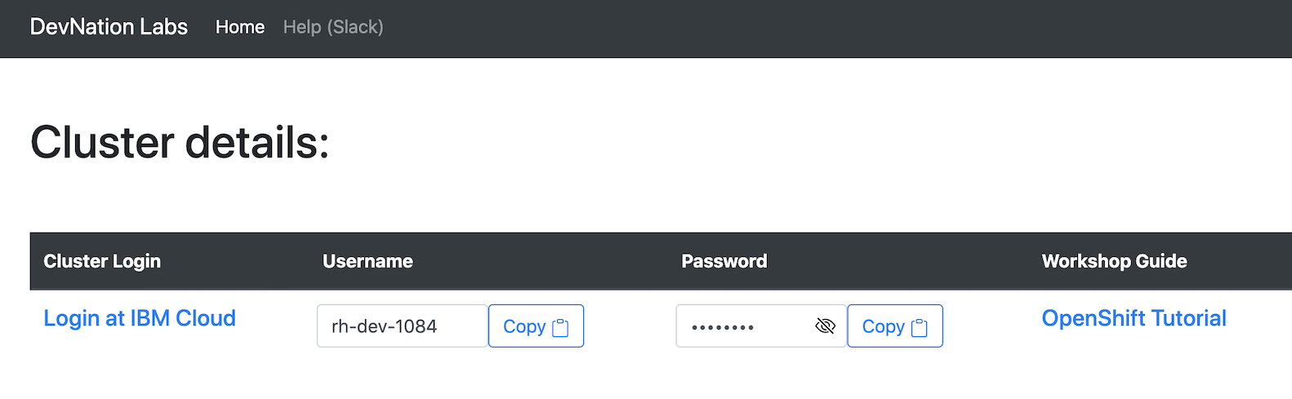
To get your OpenShift Cluster -
Cluster Portal
The cluster portal URL will be in the chat or Slack
Use your email address you used to register for this event as your personal id
Your lab guide is here
Your IBM Cloud portal link

Slide 68
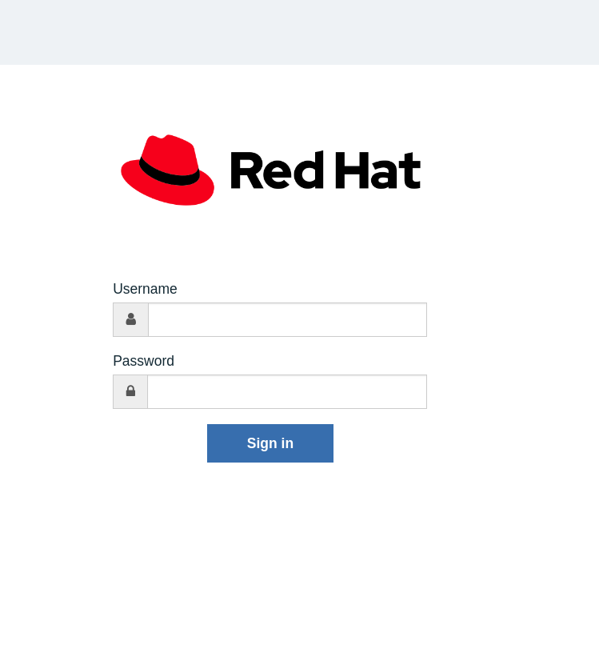
To get your OpenShift Cluster -
Login to IBM Cloud
Use username and password you received in your lab guide or displayed in the portal
Click Sign In

Slide 69
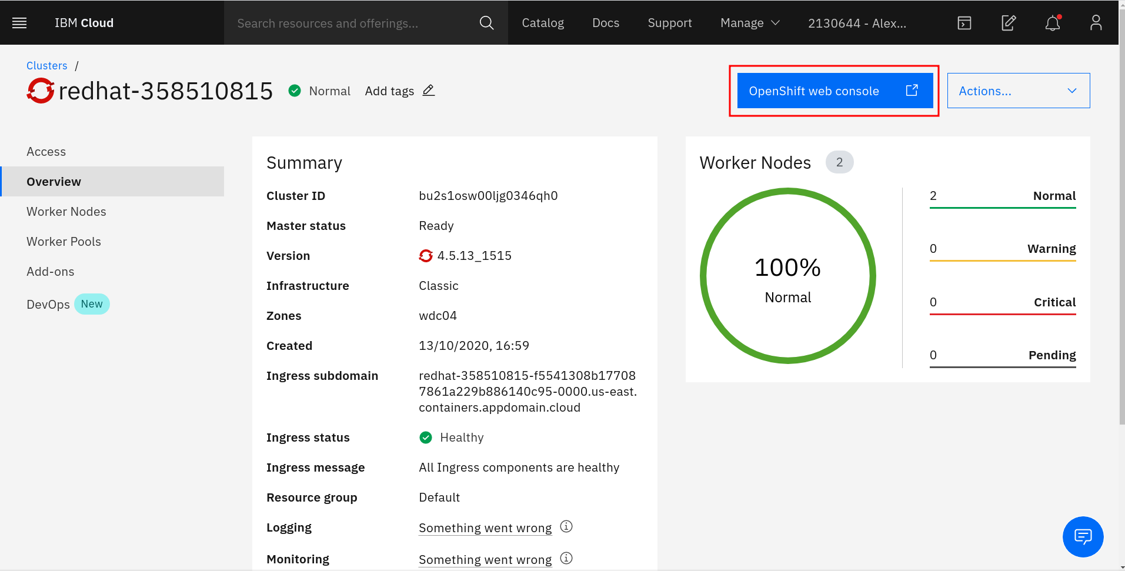
To get your OpenShift Cluster -
IBM Cloud Portal
From right side, click OpenShift web console button to access your cluster
You will be automatically logged in inside your OpenShift cluster

Slide 70
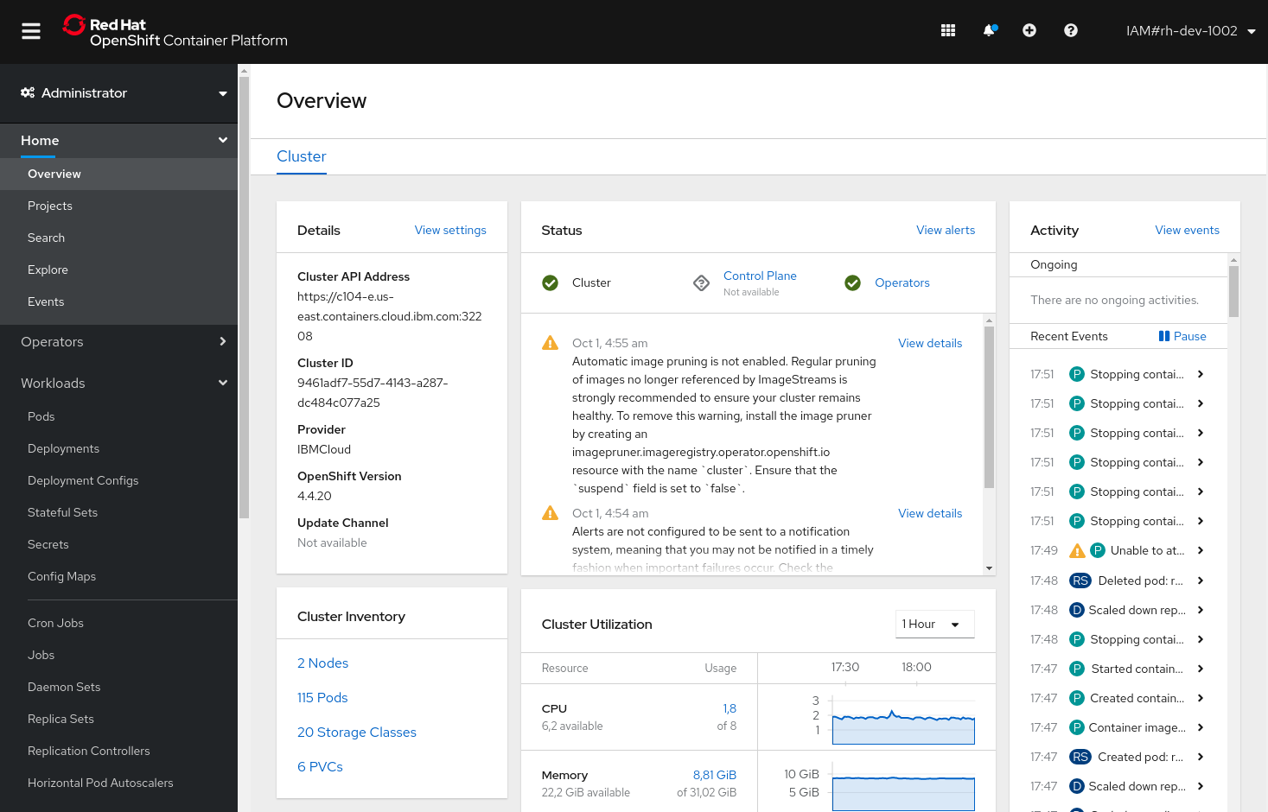
To get your OpenShift Cluster -
OpenShift Web Console
You are running your OpenShift cluster as Administrator
An Overview of the cluster with metrics and status is the entry point of your OpenShift experience
Start following the tutorial for Getting Started with OpenShift in YOUR lab guide

Slide 71
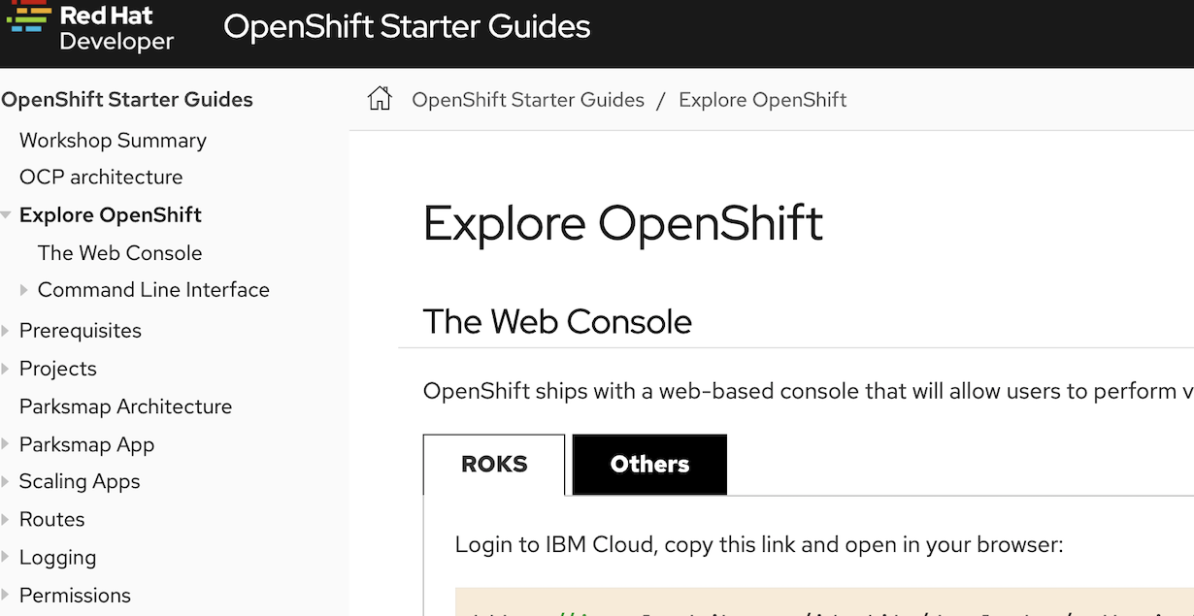
To get your OpenShift Cluster -
Lab Guide
Your lab guide is personalised
Gives instructions on getting started
And task based exercises
It is designed for the IBM Cloud cluster we provide
But can be used with other OpenShift installation
Today, please follow any ROKS options - this basically means IBM Cloud

Slide 72
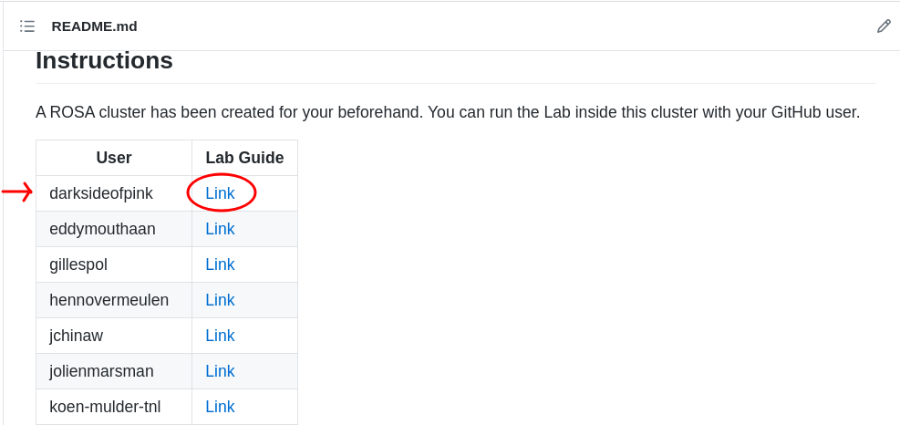
Get your Lab Guide Link
https://bit.ly/openshift-lab-orange
Look for your GitHub user
Click on your Lab Guide link

Slide 73
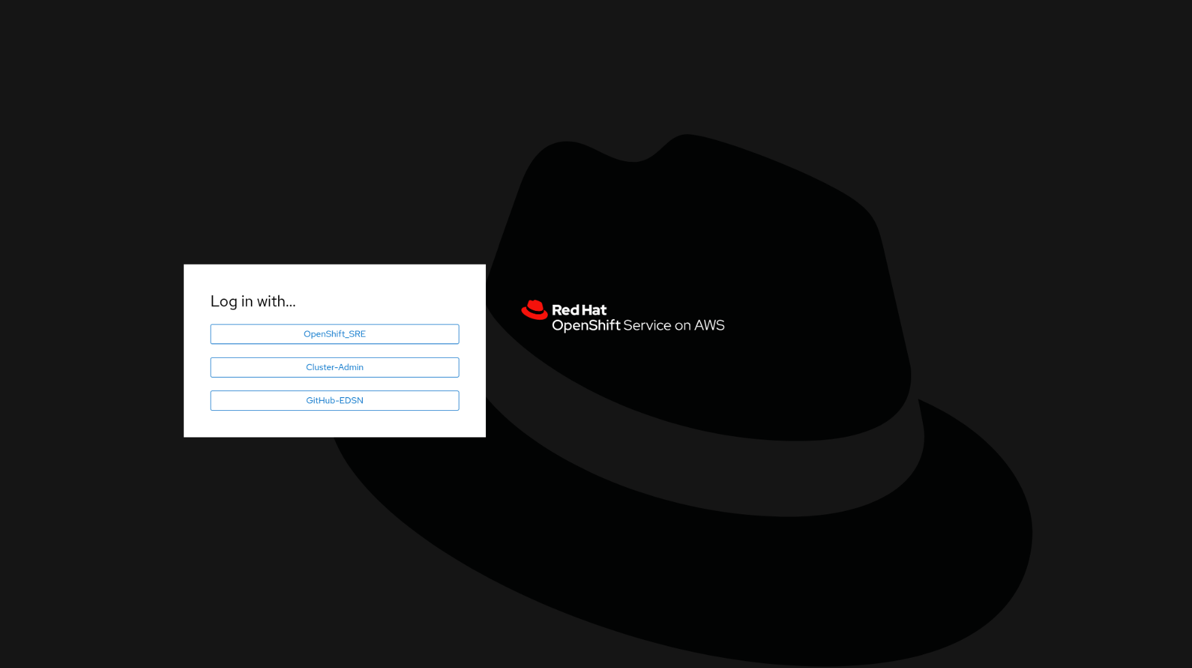
Login to your ROSA cluster
Click to GitHub- Orange

Slide 74
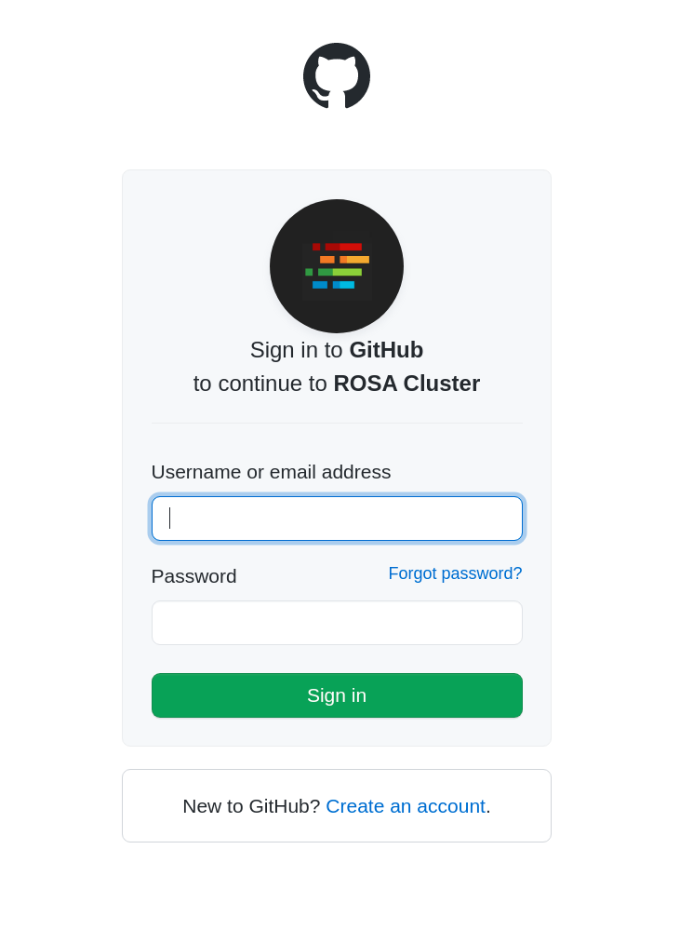
Login to your ROSA cluster
Login to the cluster with your
GitHub user

Slide 75
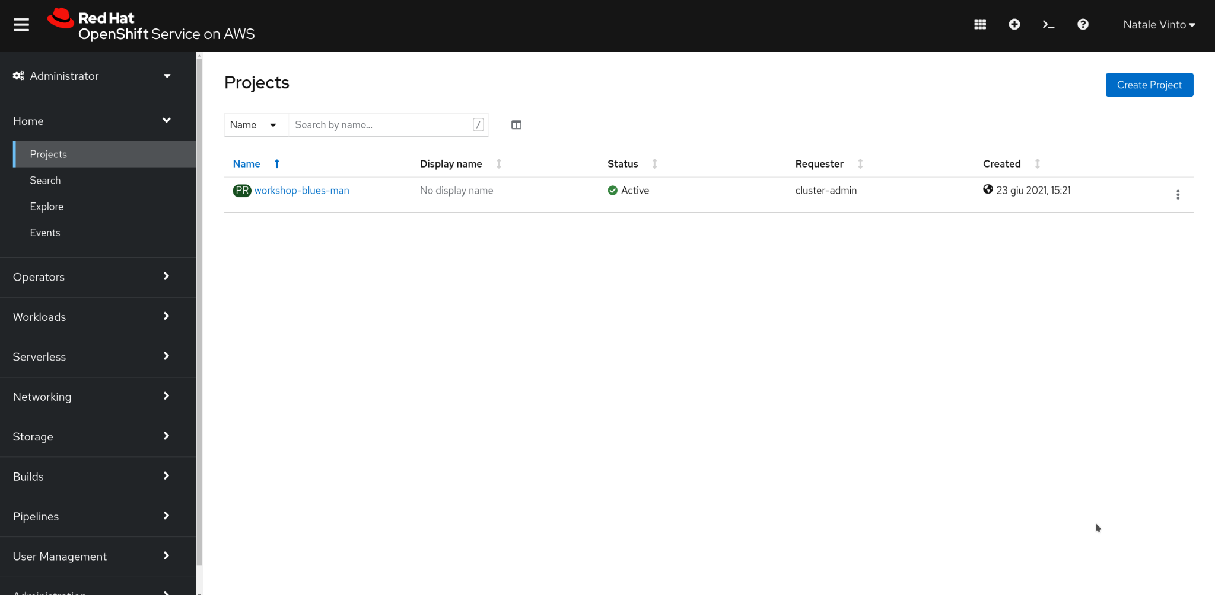
Access your Project workshop-<github_username>

Slide 76
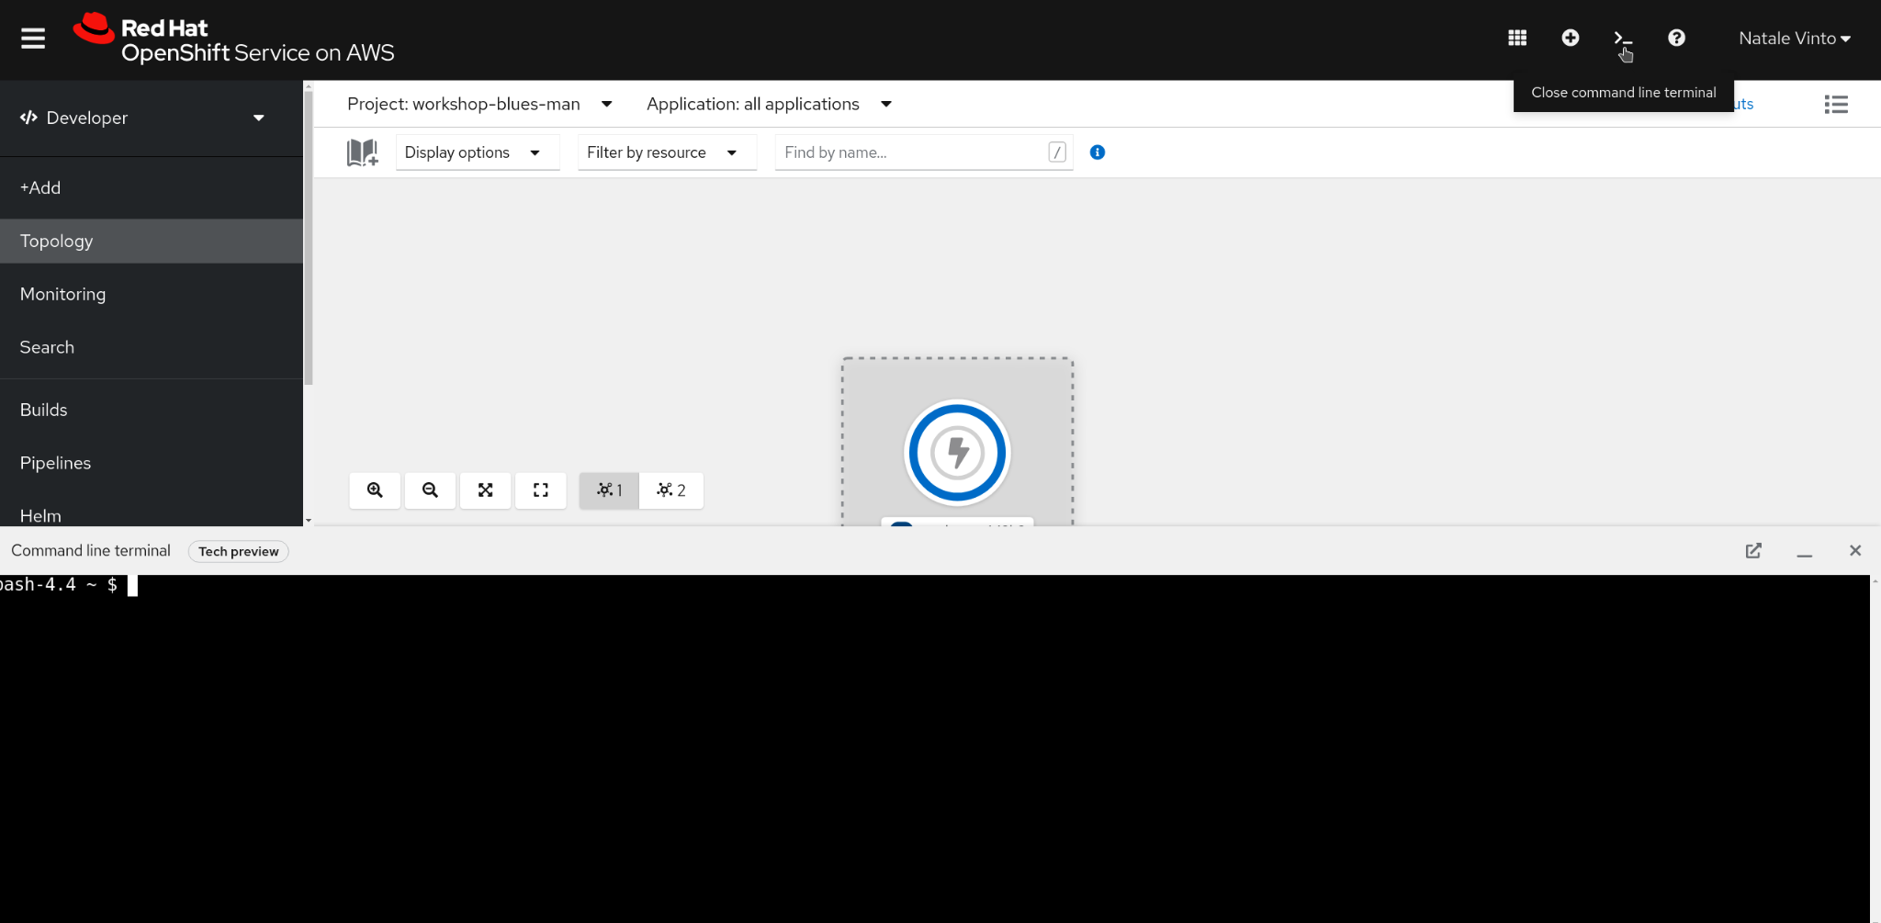
Access Developer Console and open Web Terminal

Slide 77
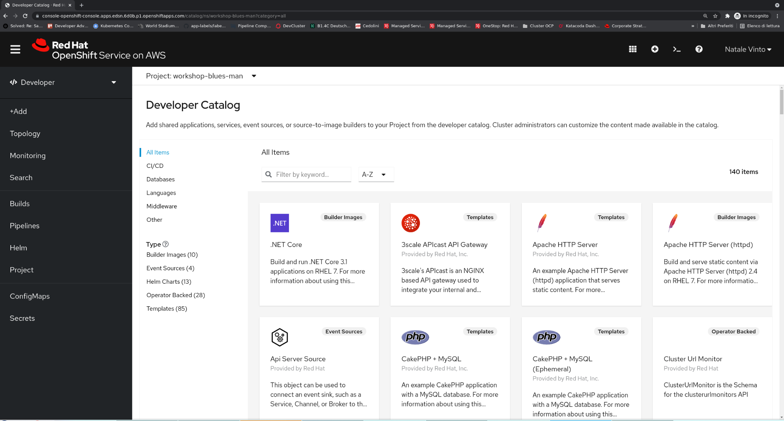
To get your OpenShift Cluster - OpenShift Web Console
You are running your OpenShift cluster as normal user
An Overview of your projects with metrics and status is the entry point of your OpenShift experience
Start following the tutorial for Getting Started with OpenShift in YOUR lab guide

Slide 78
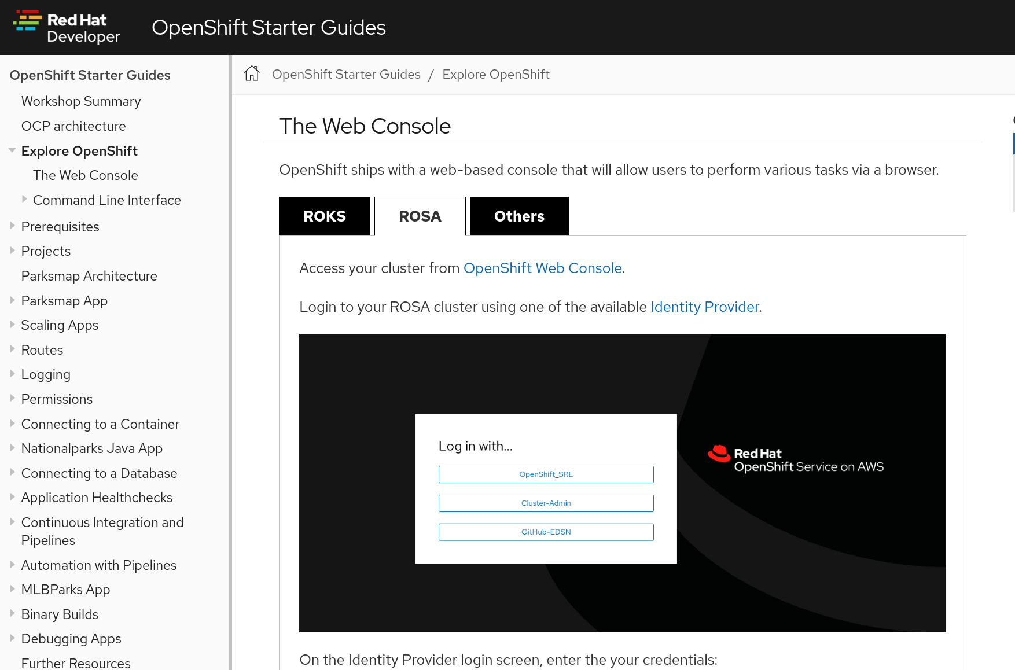
To get your OpenShift Cluster - Lab Guide
Your lab guide is personalised
Gives instructions on getting started
And task based exercises
It is designed for the ROSA cluster we provide
But can be used with other OpenShift installation
Today, please follow any ROSA options

Slide 79
Developer Sandbox!
Get free access for 30 days to a self-service, cloud-hosted experience with Developer Sandbox for Red Hat OpenShift.
NOTE: This service is in Beta version and has limited resources per user (e.g. fixed number of projects, you can’t install Operators, limited memory)
https://developers.redhat.com/developer-sandbox

Slide 80
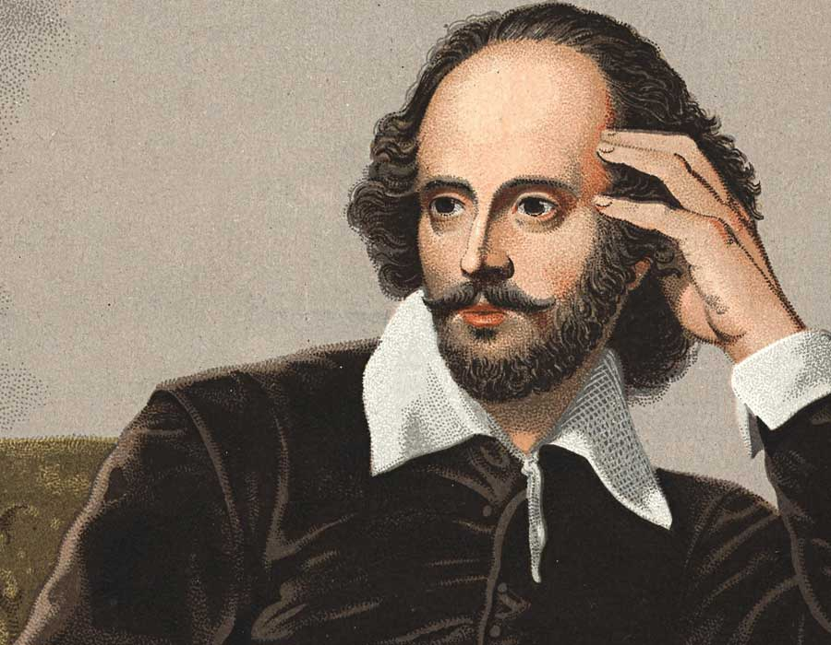


CLI or not CLI -
that is the question?
William Shakespeare - To be or not to be
https://www.menti.com/wxio5dugfr
Notes:
Click to show animations for QR Code

Slide 81
Service Mesh

Slide 82
Network Of Services

Slide 83
What About Failure Of A Service?
X

Slide 84
Cascading Failure
X
X
X
X
X
X
X

Slide 85
Isolate Failure
X

Slide 86
Microservice - Library Based Development
Container
Container
JVM
Node.js
Service A
Before
Service C
Discovery
Discovery
Load-balancer
Load-balancer
Resiliency
Resiliency
Metrics
Metrics
Tracing
Tracing
Container
JVM
Service B
Discovery
Load-balancer
Resiliency
Metrics
Tracing

Slide 87
Service Mesh - Externalized Capabilities
“Sidecar” enabled
Pod
The sidecar intercepts all network traffic
Pod
Container
Container
JVM
Node.js
Service A
Service C
Sidecar Container
Sidecar Container
Pod
Sidecar Container
Container
JVM
Service B

Slide 88

Service Mesh Data Plane Vs Control Plane
Data
Plane
Pod
Pod
Pod
Container
Container
Container
JVM
JVM
Node.js
Service A
Service B
Service C
Envoy Sidecar
Envoy Sidecar
Envoy Sidecar
Control
Plane
Galley
Pilot
Mixer (telemetry, policy)
Citadel
Notes:
As you can see, alongside the data plane of communicating components we also have a control plane.
We have some boxes here that provide telemetry, control, configuration and security but not really time to delve into these too much today

Slide 89
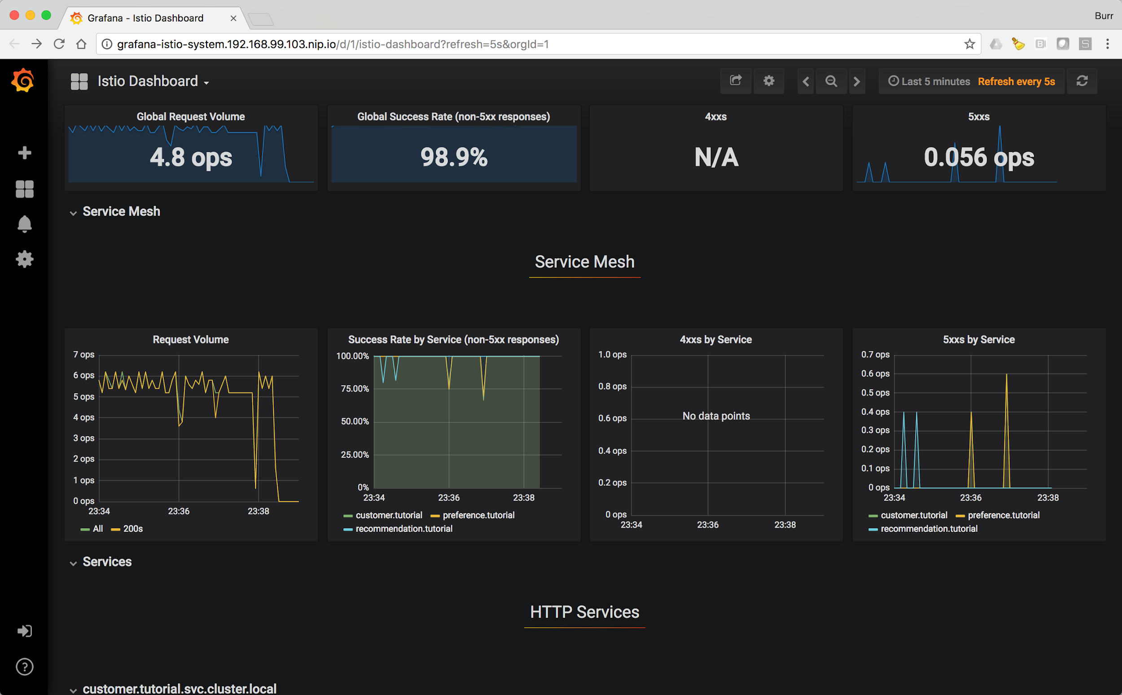
Observability

Slide 90
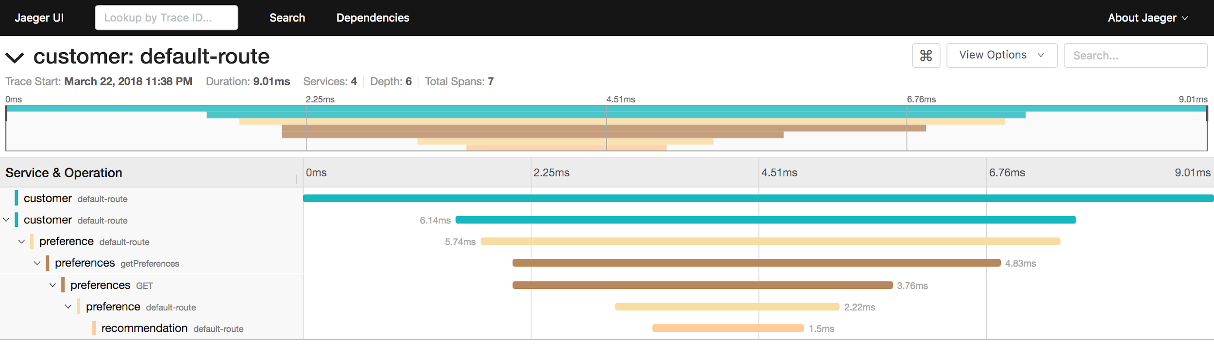
Call Level Tracing

Slide 91
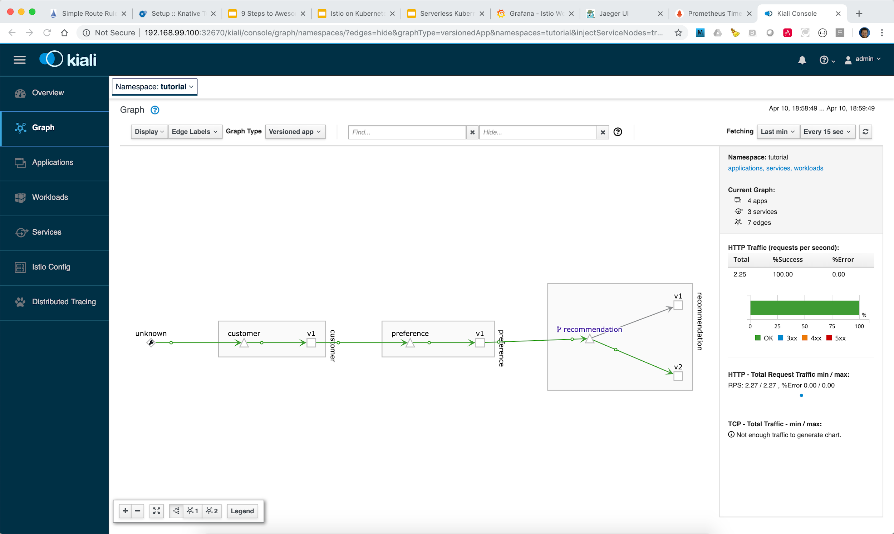
Visualise Service Topology

Slide 92
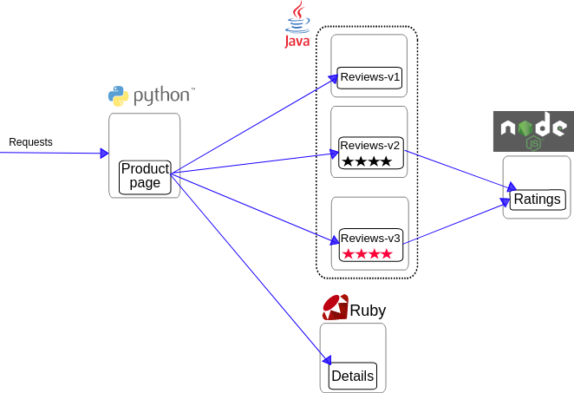
Bookinfo app
Install Service Mesh from OperatorHub
Install Bookinfo app
Run Traffic Management (Canary, Circuit-breaking,..)
Service Mesh Demo

Slide 93
Serverless Demo

Slide 94
Kafka Streams + Serverless

Slide 95
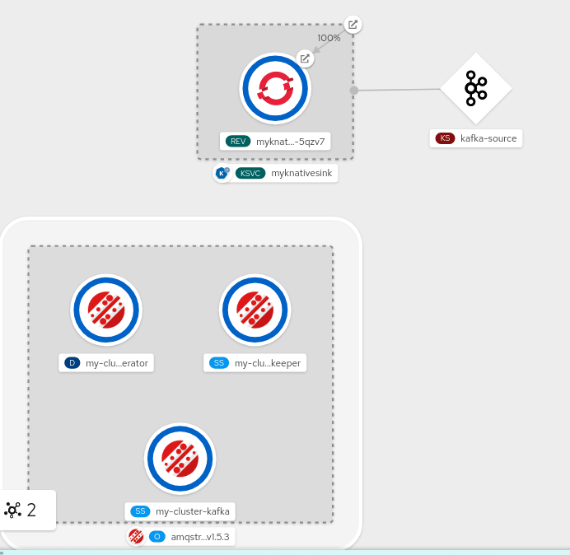
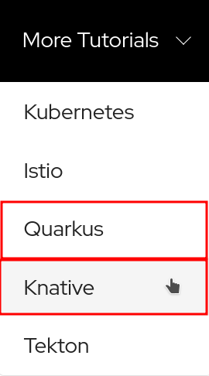
Want More? Knative+Quarkus!
Follow Knative Tutorial from top-right link inside your Lab Guide
Serverless
Eventing
Camel-K
Quarkus
Demo source is available here:
https://github.com/burrsutter/knative-kafka

Slide 96
Additional Resources

Slide 97
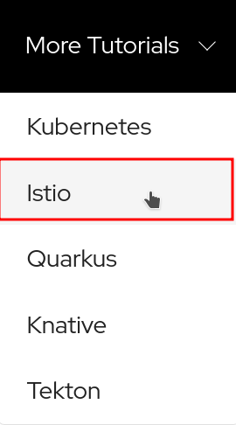
Want More - Tutorials!
Follow the More Tutorials from top-right link inside your Lab Guide
Kubernetes
Istio
Quarkus
Knative
Tekton
Static tutorial: dn.dev/openshift-tutorial

Slide 98
Want More - Labs!
learn.openshift.com
Using OpenShift
Developing on OpenShift
GitOps and Pipelines
Serverless
Operators
Istio
Storage
AI/ML
Quarkus
Playgrounds - full cluster for an hour

Slide 99
Want More - Developer Sandbox!
Get free access for 30 days to a self-service, cloud-hosted experience with Developer Sandbox for Red Hat OpenShift.
NOTE: This service is in Beta version and has limited resources per user (e.g. fixed number of projects, you can’t install Operators, limited memory)
https://developers.redhat.com/developer-sandbox

Slide 100
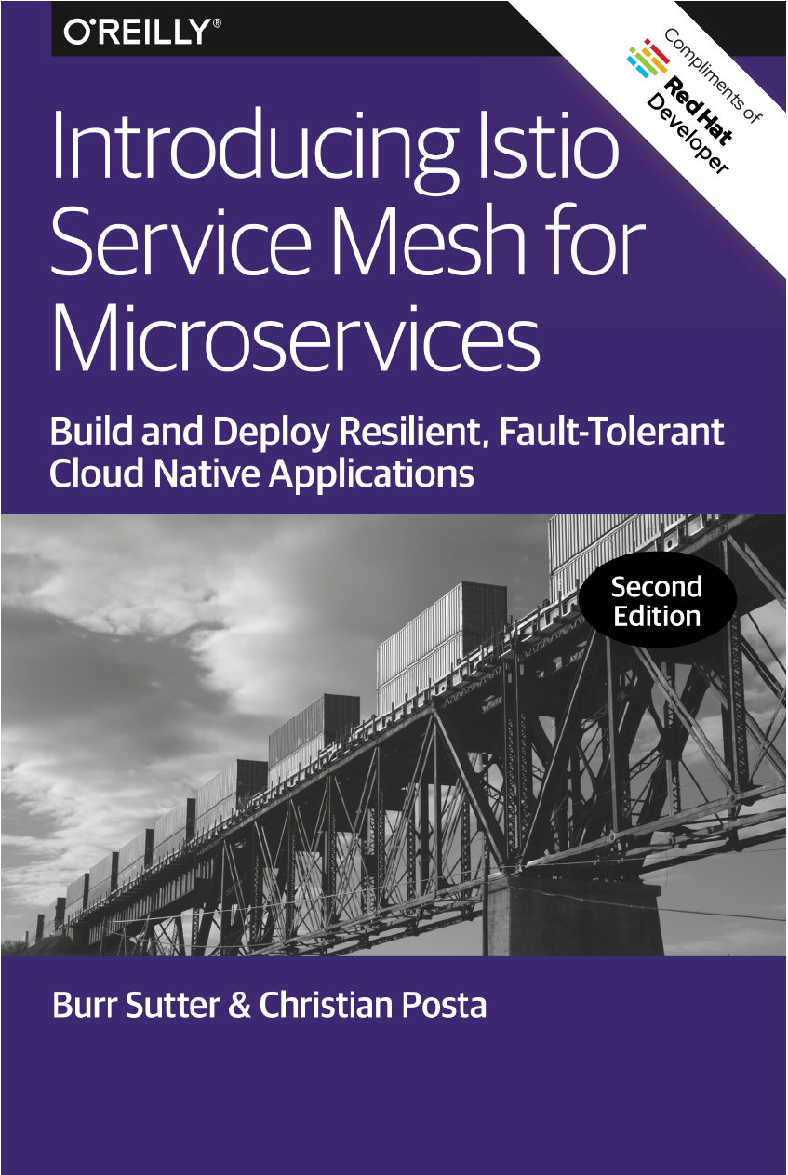
Download
https://dn.dev/istiobook

Slide 101
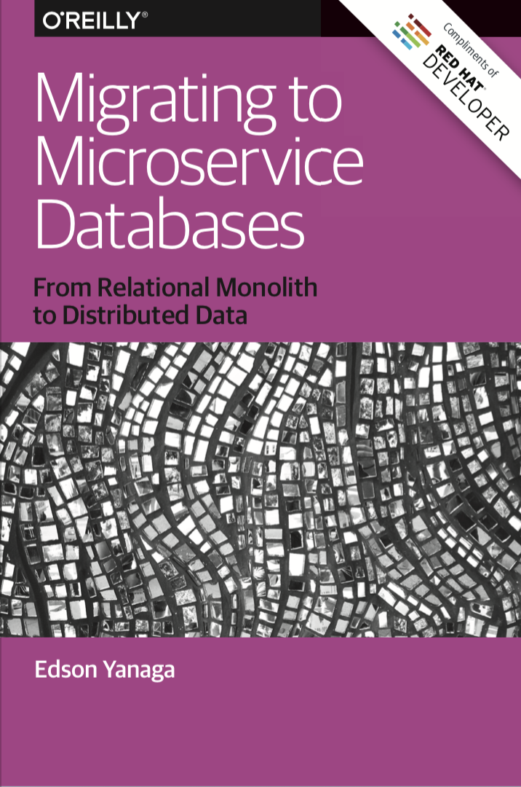
Download
https://bit.ly/mono2microdb

Slide 102
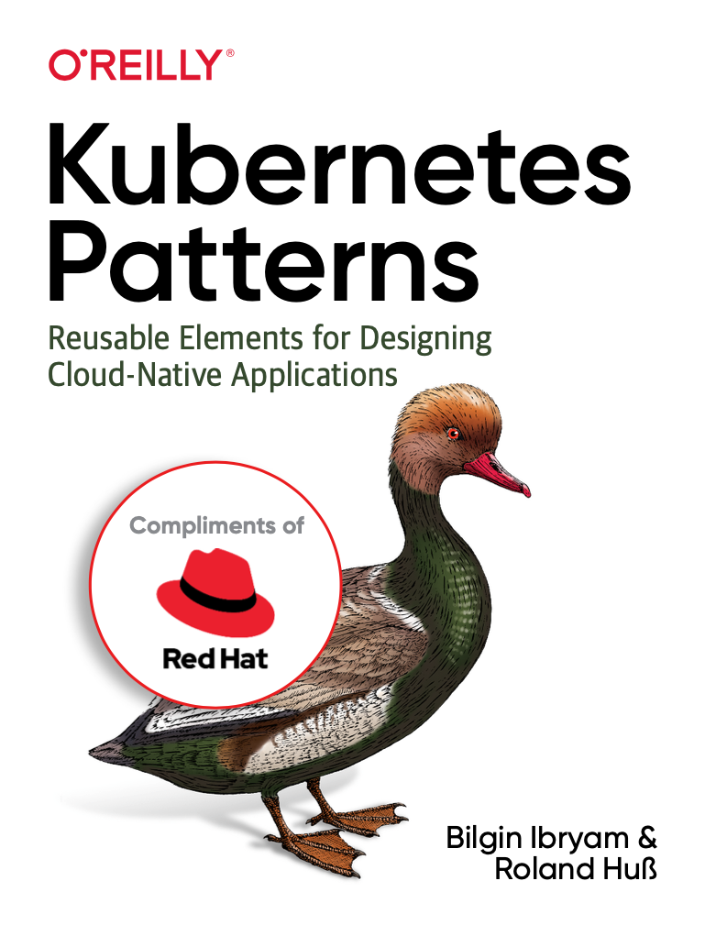
Download
https://dn.dev/k8s-patterns

Slide 103
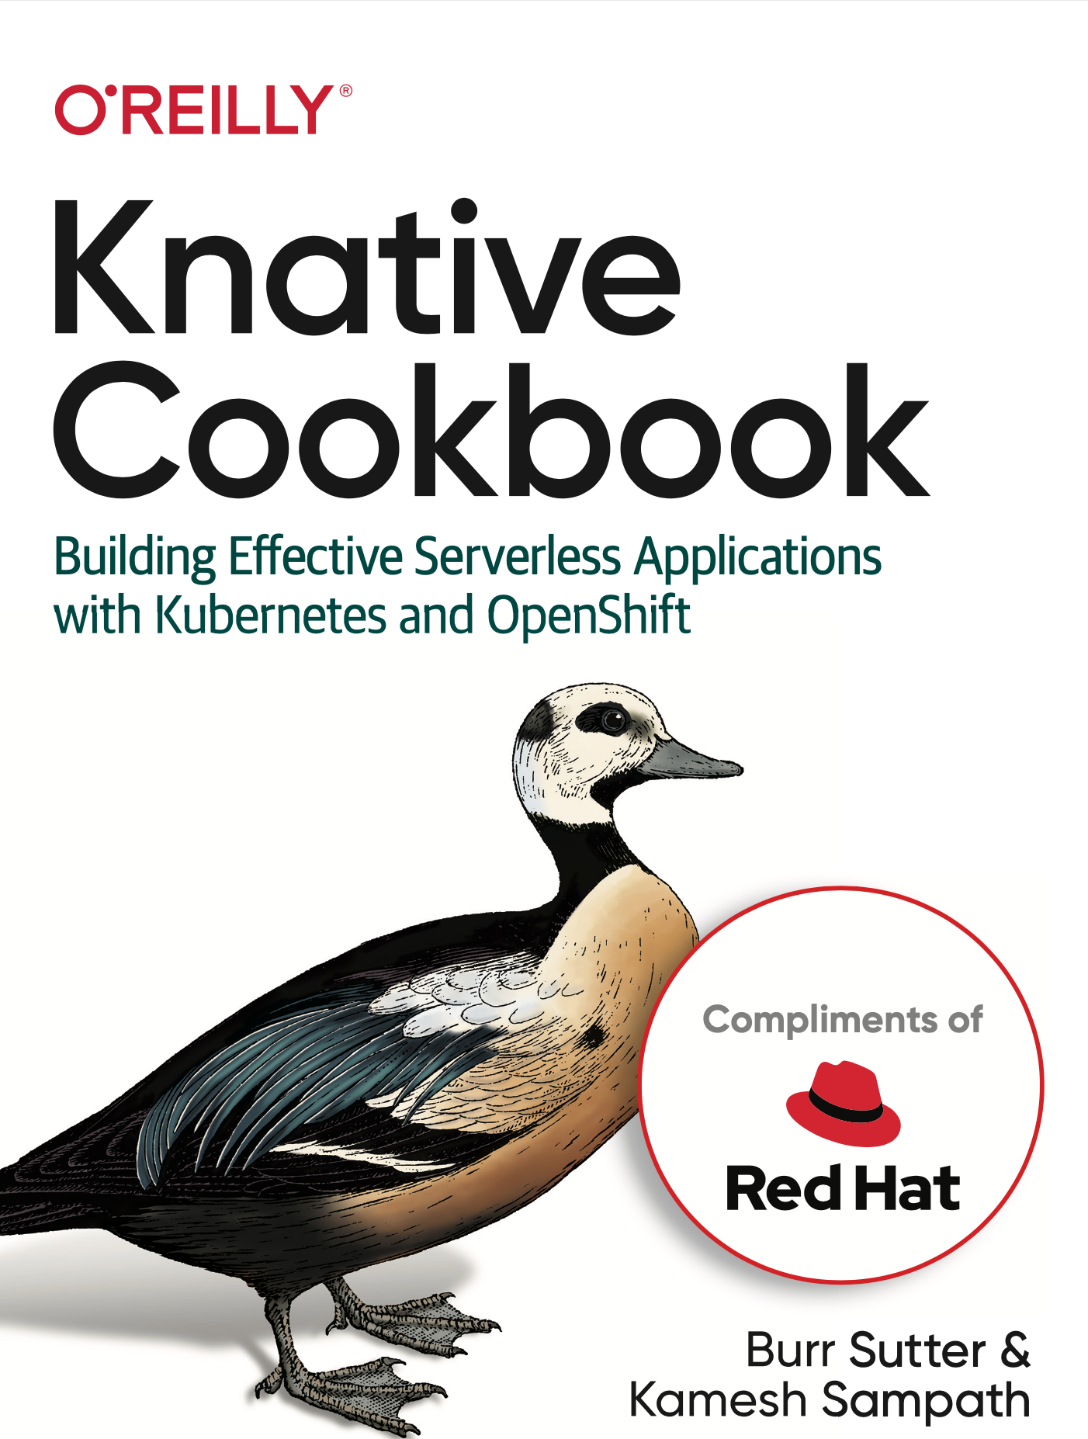
Download
dn.dev/knative-cookbook

Slide 104
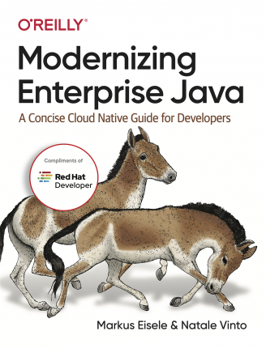
Download
https://red.ht/modernize-enterprise-java

Slide 105

Red Hat Summit Virtual Experience
Two-part virtual experience. One registration.
APRIL 27-28
JUNE 15-16
What to expect:
Keynotes from Red Hat thought leaders
Exciting news and announcements
Global customer and partner spotlights
Live demo
Access to Red Hat experts
Games and entertainment
What to expect:
7 channels of breakout sessions
Technical, deep-dive content
Even more access to Red Hat experts
Customer stories and global content
Demos, chat lounges & community engagement
Visit our website and register now
Read the blog for more information

Slide 106
Red Hat Summit 2021
https://www.redhat.com/en/summit/agenda

Slide 107
Thank You!

